Slide 1
FAM TRIP
MARCH – OCTOBER 2020

Slide 2
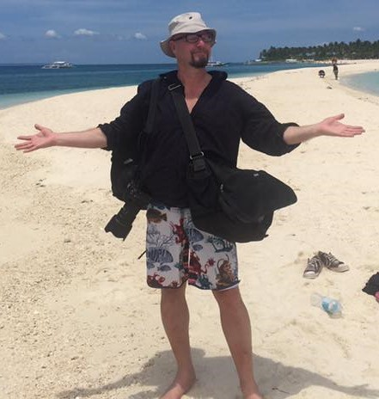
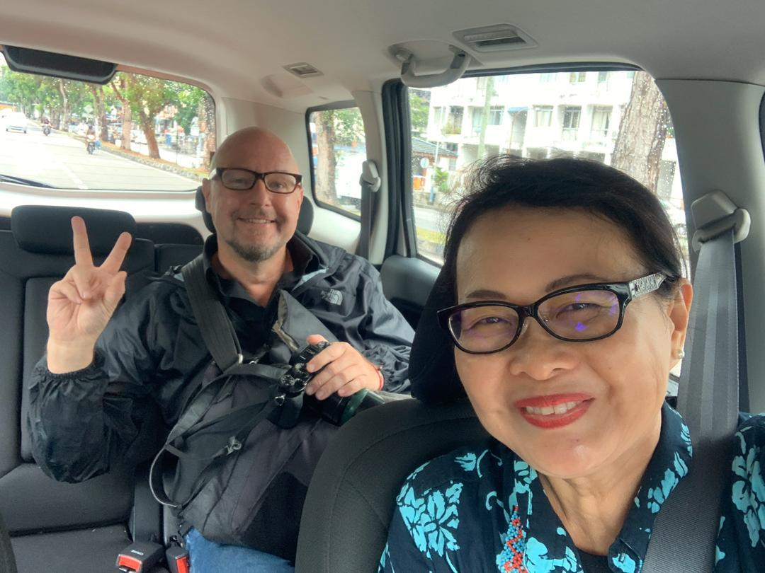
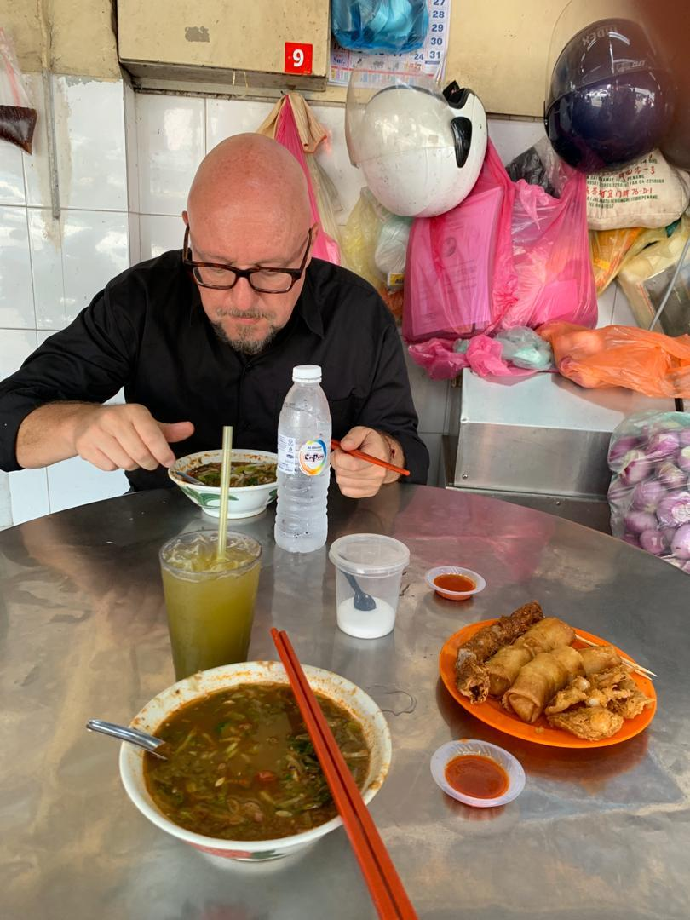
SWEDISH FAM
Mr Anders Pilh is a Swedish travel journalist and also a photographer with over 15 years experience. He also a freelances for many of the largest publications in Sweden and Scandinavia. He has now a commission from Bonniers, the leading media house in Sweden, for writing a long travel article which reach of 4,7 million readers. Anders Pilh stayed in Penang 4 days and he featured Penang attraction, local food and lifestyle for his magazine. For more information can visit www.anderspihl.com.

Slide 3
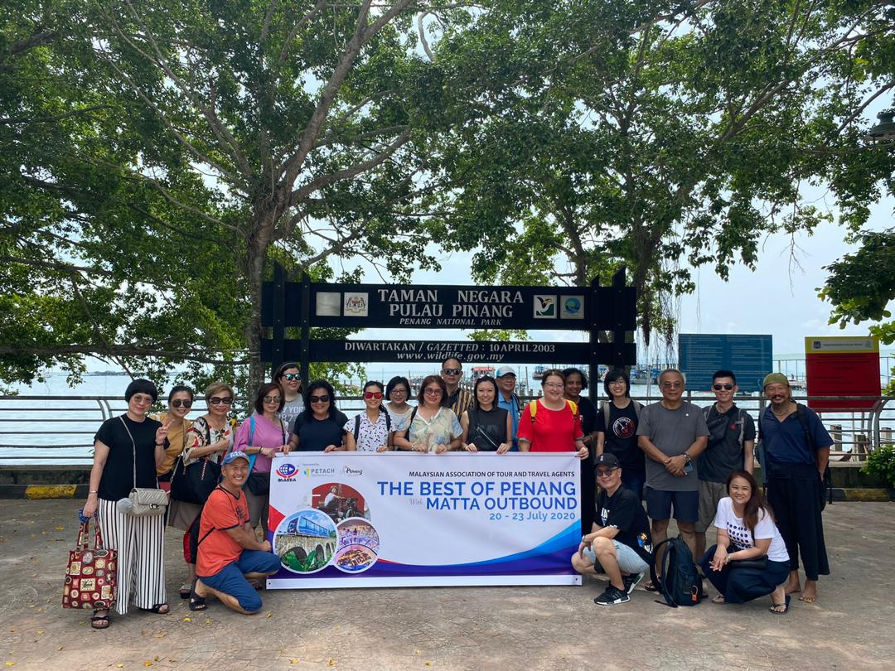
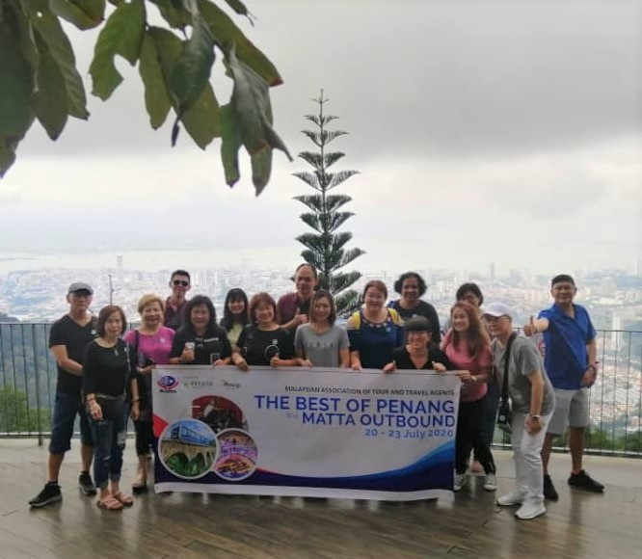
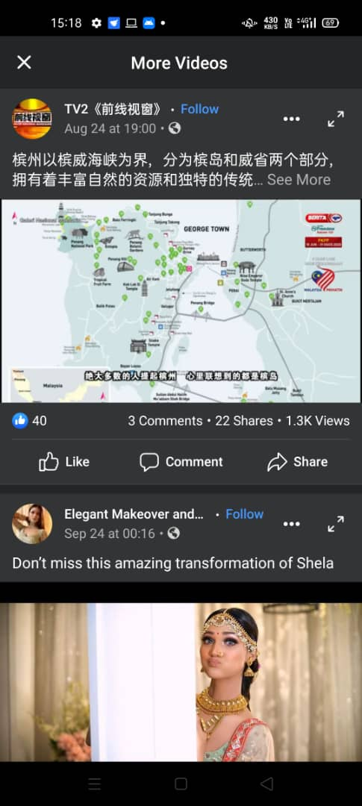
OUTBOUND TRAVEL AGENTS & MEDIA FAM
FIRST BATCH
Malaysian Association of Tour and Travel agents (MATTA) organised a FAM trip for the Top outbound Travel Agencies in Klang Valley to Penang. There are 2 groups which are bumiputras and non bumiputras group. The first batch are non bumiputras followed by TV2 Media person and they cover new attraction in Penang such as Kampung Agong, Fruit farm and Genting Hill leisure park & Restaurant. On the last day of Familiarisation trip PETERAB arranged a networking session with all Tourism players in Penang and also a townhall session with YB Yeoh Soon Hin, the state EXCO for Tourism, Arts, Culture and Heritage.

Slide 4
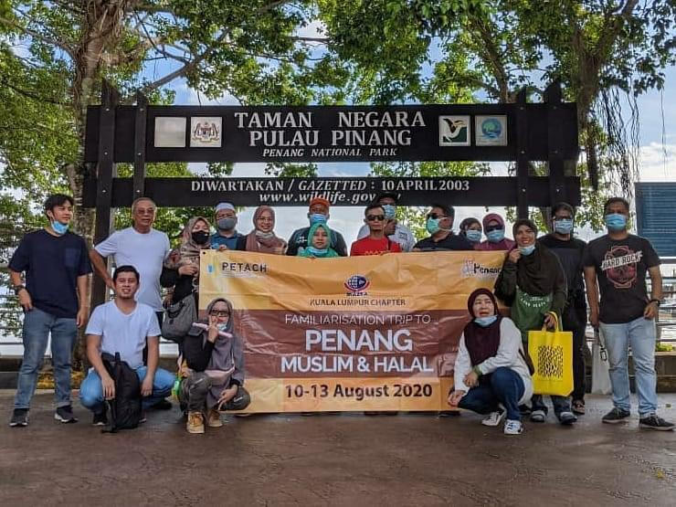
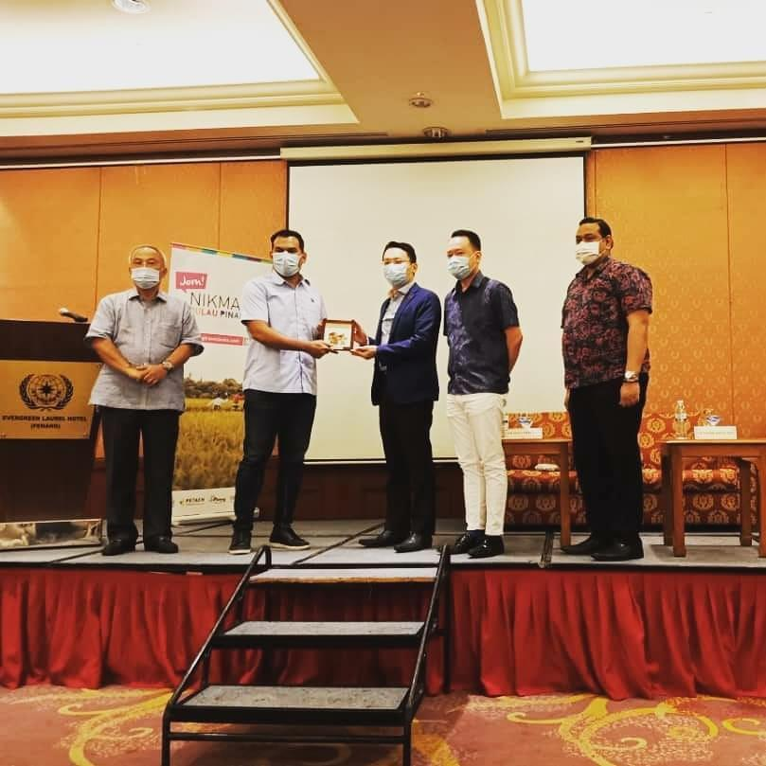

OUTBOUND TRAVEL AGENTS & MEDIA FAM
SECOND BATCH
Malaysian Association of Tour and Travel Agents (MATTA) has initiated FAM Trip to the Top outbound travel agencies in Klang Valley to Penang. The second batch agents will be bumiputras. The objective for this FAM trip is to convert the outbound travel agencies customers to plan their holidays and corporate events to be held in Penang. This group focus more on island hoping in Penang such as Pulau Aman, Pulau Gedung, Pulau Batu Puyung and Pulau Jerejak. On the last day of Familiarisation trip held a networking session with Hotels and attraction in Penang and also a townhall session with YB Yeoh Soon Hin, the state EXCO for Tourism, Arts, Culture and Heritage.

Slide 5
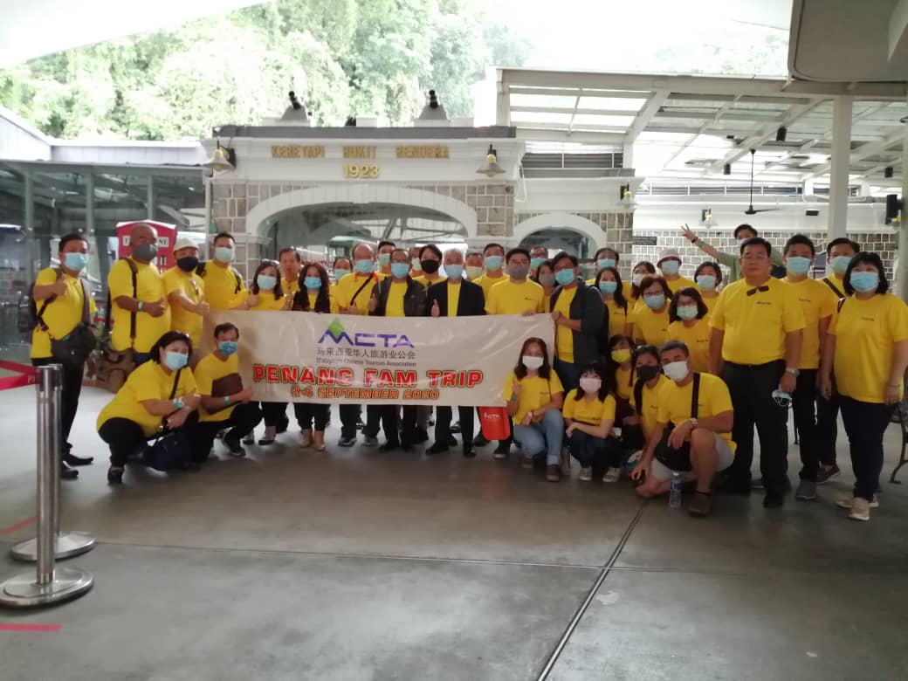
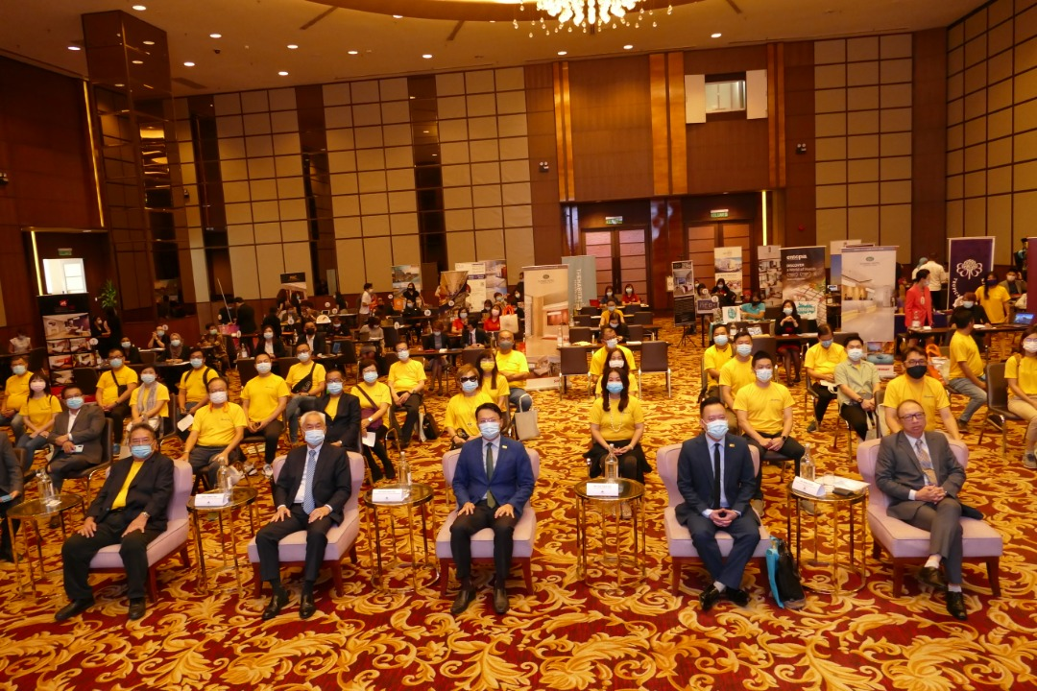
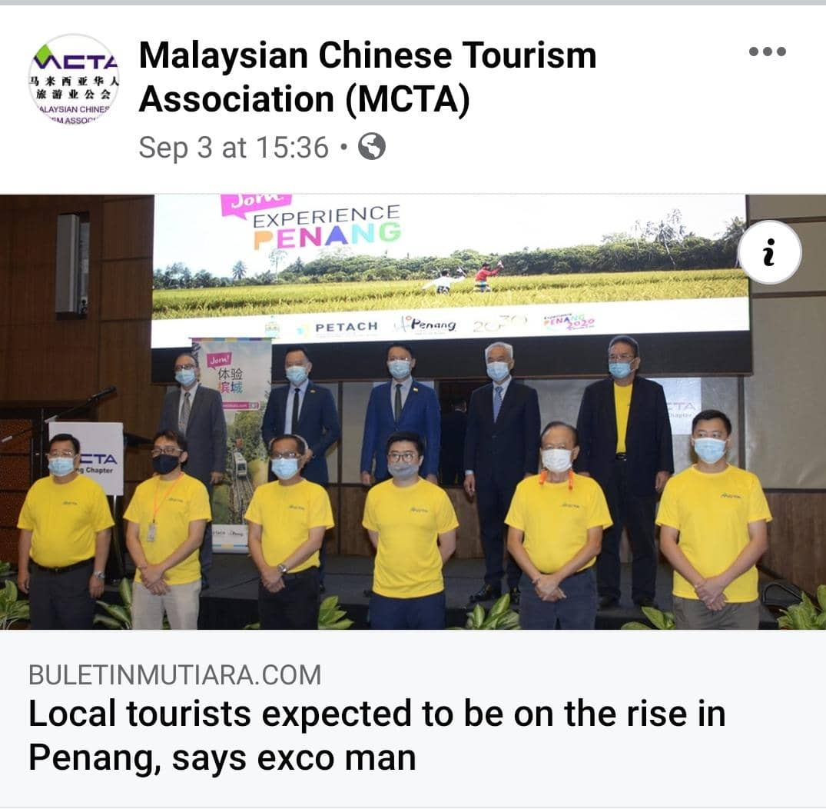
MCTA TRAVEL AGENTS FAMILIARIZATION TRIP
Malaysian Chinese Tourism Association (MCTA) was initially incorporated by a group of concerned and dedicated Malaysian Chinese travel agents. It was officially registered with the Registrar of Societies (ROS) on 14th Sept 1992. MCTA have a total membership of 1,005 members nationwide. The Malaysian Chinese Tourism Association (MCTA) Penang Chapter organized FAM trip for 40 travel agents from different state. Objective of this FAM trip is to encourage the Malaysian to focus on domestic tourism as international border still closed. The objective is to build a networking with Penang players and create attractive packages during B2B session and also as a recovery plan.

Slide 6
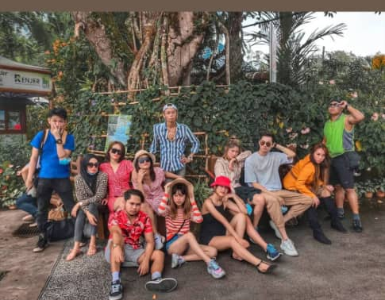
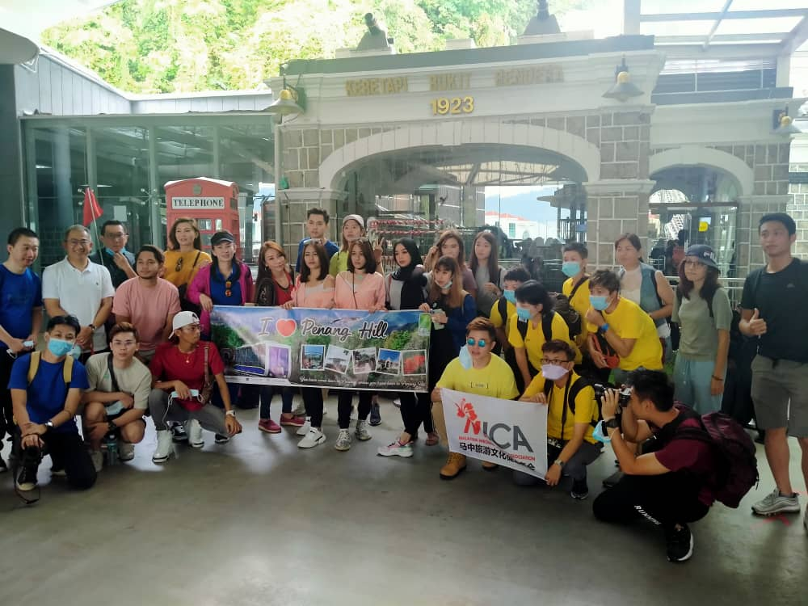
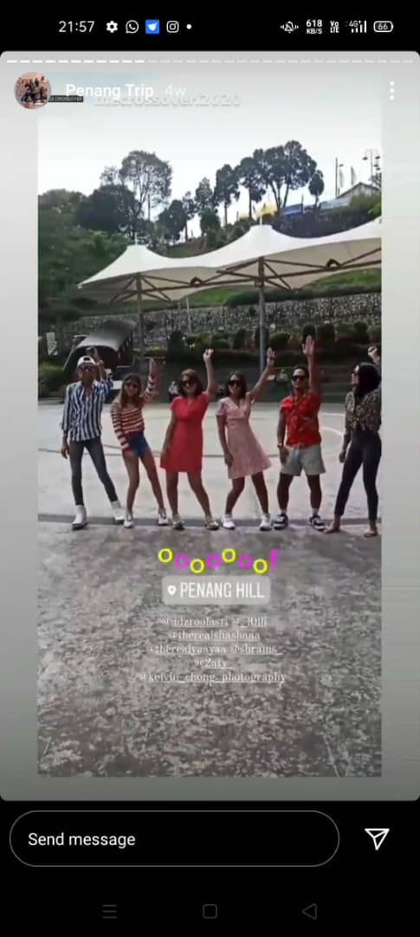
MICA (MALAYSIA INBOUND CHINESE ASSOCIATION) KOL FAM
MICA (Malaysian inbound Chinese Association) has organised FAM for KOL from different state to promote Penang. The main objective of the Association is to assist and gather all tour operators and tourism-related industry members. Malaysian Inbound Chinese Association is a registered non-government and non-profit organization under the registrar of Society of Malaysia. The FAM trip will be covering all tourism areas include Mainland . The objective of this FAM to reactive Penang Tourism and encourage people to explore Penang and support domestic market. Total 12 KOL participate in this FAM who built their names on popular niche blogs and Sosial media in return they will promote the attraction on their social media page.

