Slide 1
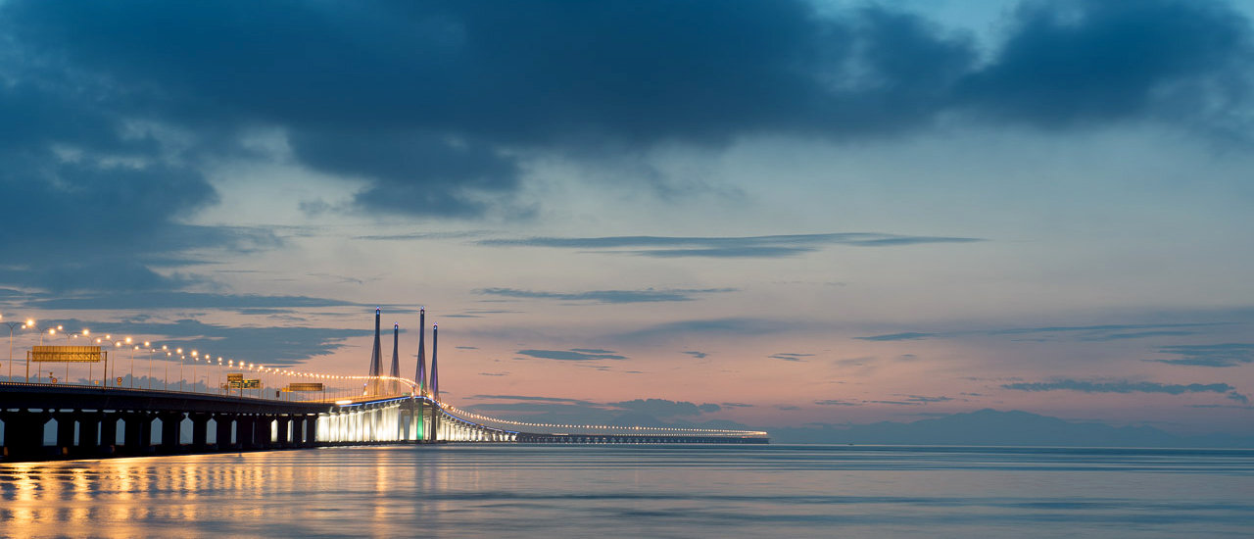








Grand Prize
10.2 Inch Ipad
3D2N ParkRoyal Penang Resort
2× Ghost Museum
2× The Habitat Penang Hill
2× The Top Penang
1× The Gravityz

Slide 2

Grand Prize
10.2 Inch Ipad
2D1N Angsana Teluk Bahang Penang
2× Ghost Museum
2× The Habitat Penang Hill
2× The Top Penang
1× The Gravityz

Slide 3

Grand Prize
Huawei Mate 30 Pro
3D2N Clans Kongsi
2× Ghost Museum
2× The Habitat Penang Hill
Gravityz

Slide 4




Grand Prize
Coach Woman Wallet by Design Village
2D1N The Prestige Hotel Penang
1× Cooking Class in Tropical Spice Garden
2× The Habitat Penang Hill
1× Ghost Museum

Slide 5


Grand Prize
Bonia Handbag 1 unit
2D1N Hotel Equatorial Penang
1× set Live guided tour in Tropical Spice Garden
1× The Gravityz
1× Ghost Museum

Slide 6


Prize
3D2N in Iconic Hotel

Slide 7


Prize
2D1N in Travelodge Georgetown

Slide 8

Prize
2D1N in Grand Orient Hotel

Slide 9

Prize
2D1N in Royale Chulan Penang

Slide 10

Prize
2D1N in Flamingo Hotel by the Beach Penang

Slide 11

Prize
2D1N in Jazz Hotel Penang

Slide 12

Prize
2D1N in Hotel Penaga

Slide 13

Prize
2D1N in Vouk Hotel Suites Penang

Slide 14

Prize
2D1N Hotel Neo+ Penang By Aston

Slide 15
Prize
One set Live Guided Tour in Tropical Spice Garden

Slide 16

Prize
2 Tickets of The Top “Top Day Fun Pass”

Slide 17
Prize
2 Tickets The Gravity ride

Slide 18
Prize
2 Tickets Penang Best Attraction by Ghost Museum

Slide 19
Prize
2 Tickets The Habitat Penang Hill

Slide 20

Prize
10 Voucher by Sailor Tours & Travel sdn bhd

Slide 21

Prize
2 Voucher 2D1N Sunway Hotel Georgetown

Slide 22

Prize
2 Voucher 2D1N Hotel Evergreen Laurel

