Slide 1
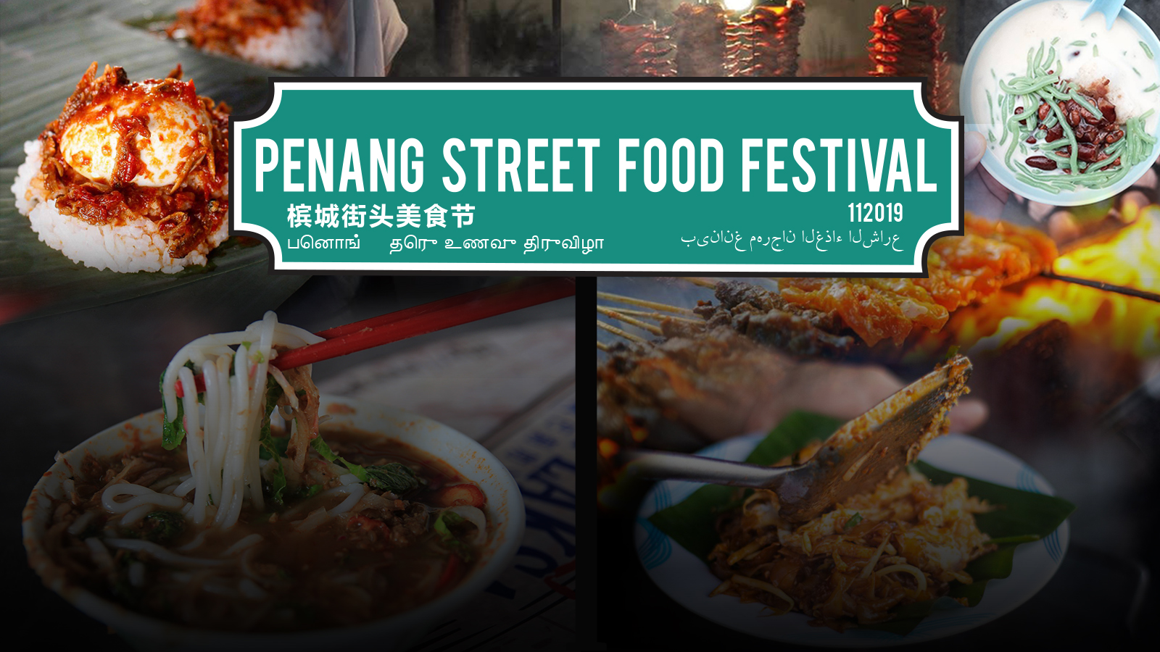

Event Concept & Proposal by Goche Corporation Sdn Bhd exclusively for Penang Global Tourism.
Attn: Ms Malathi
18 June 2019
This document is an intellectual property of Goche Corporation Sdn Bhd. Any distribution and/or duplication without consent is strictly prohibited.

Slide 2
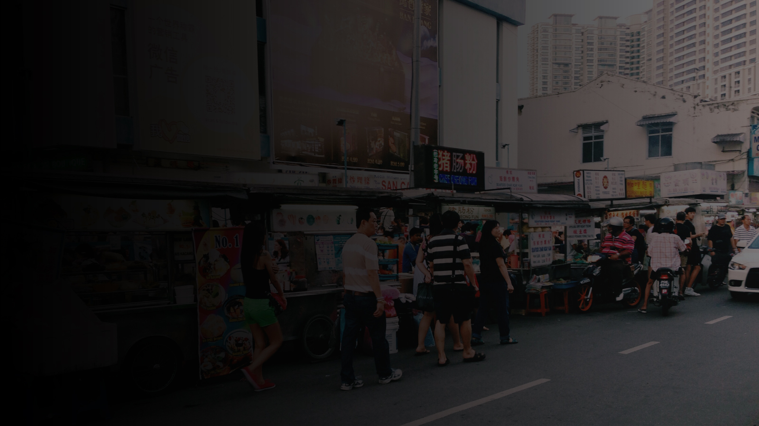
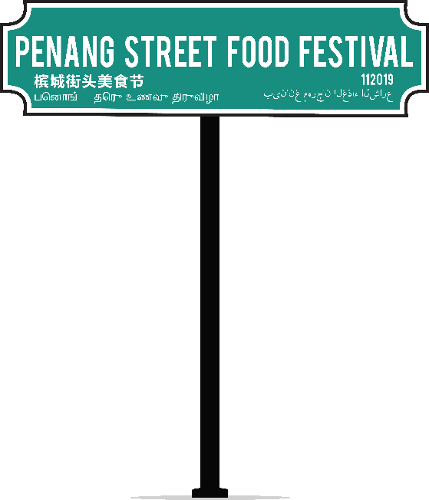
Concept & Objectives
Like all great things in life, the Malaysian food scene has an irrefutable reputation; the luscious variety in the mixture of spices, flavours and textures that are beyond words and must be experienced for one to comprehend.
What better place to understand this that the food capital of Malaysia, right smack in the heart of the Pearl of the Orient, Penang from fragrant the spicy noodle soup that is Laksa, to recipes of Hainanese Chicken Chops made by the Hainanese migrants, the melting pot of Indian, Malay, Chinese and international influences has created a true foodies’ paradise.
Every plate served will dish out either glimpse into the past, a brief little story of its coming-to-be or just merely a plethora of sensory engagements.
Either way, food is one thing everyone can enjoy, regardless of race, creed or colour.
This document is an intellectual property of Goche Corporation Sdn Bhd. Any distribution and/or duplication without consent is strictly prohibited.

Slide 3
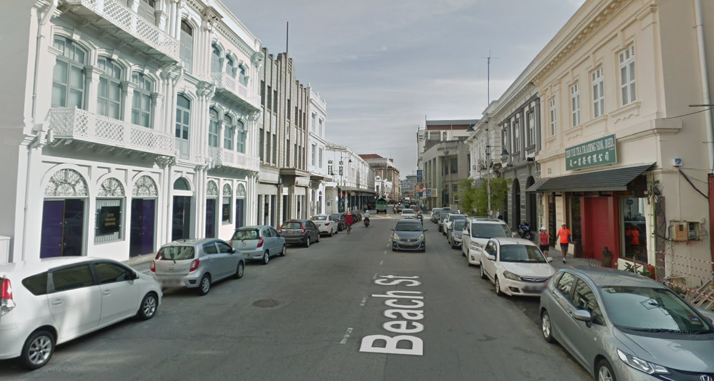
Proposed
Event Venue

Slide 4

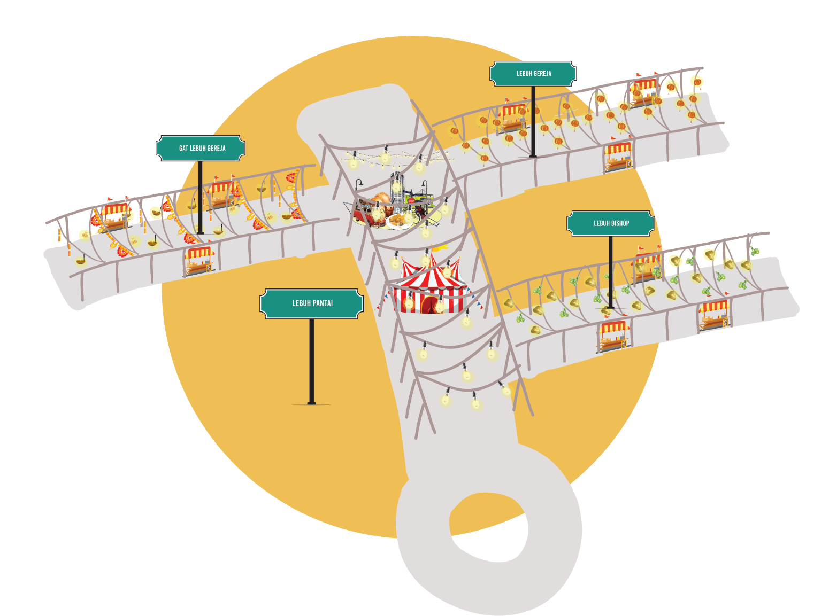
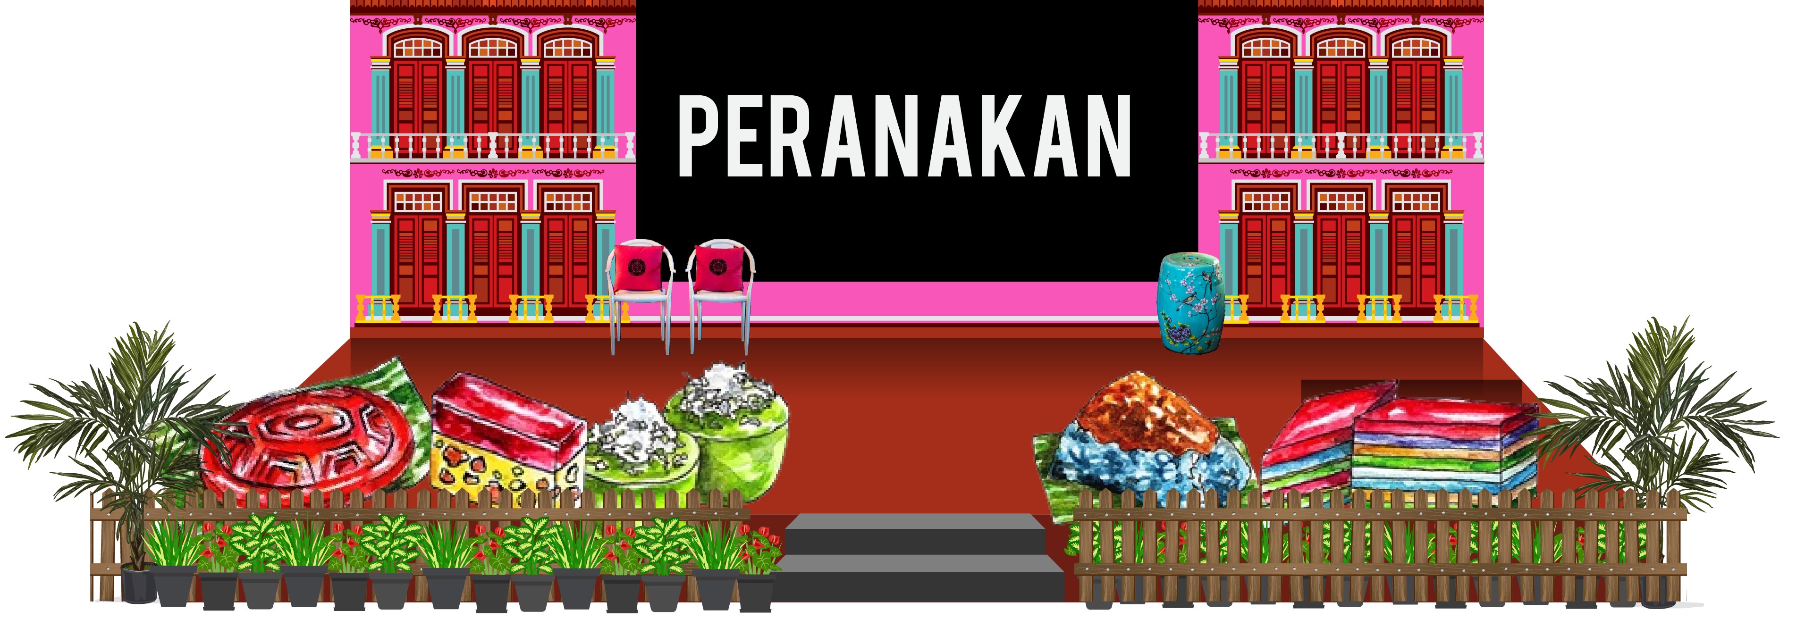
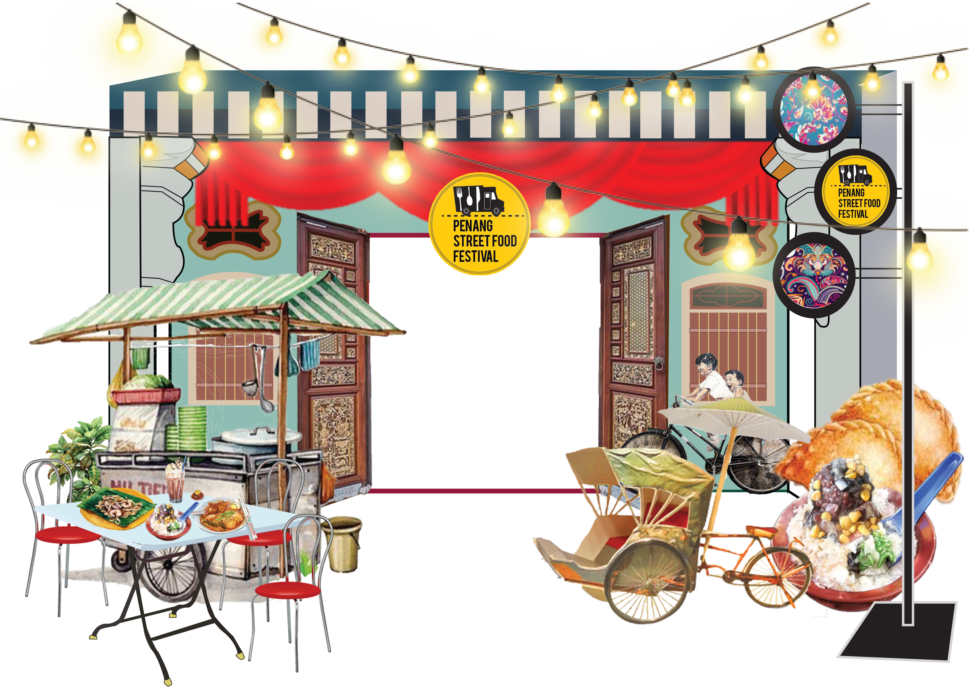
Simplified Map
Proposed
Map
  An overall street map of the Penang Street Food Festival 2019, which guides its viewers to explore the fun and tantalising foods and culture that lies in front of their eyes.
  The main street will feature:
  Main Stage (Launching & Performances)
  Featured Stalls
  Aroma Laksa
  Island Décor for photo opp
  Fun Fair

Slide 5





















Simplified Map
Proposed
160 m
160 m
Gat Lebuh Gereja
Lebuh Bishop
97 m
110 m
110 m
RHB
OCBC
Bank
Happy Mart
The
Bank
Flux
Balai
Polis
10 m
Island Decor
Main Entrance
Aroma Laksa
Indian
House
Alliance
Bank
Am
Bank
Hainanese Cuisine
:Table & Chair
125 m
:Audience Seat
:Food Stalls
:Featured
Food Stalls
Gat Lebuh Gereja
:VIP Seat
:Information Centre
:Road Block
:Fun Fair
:VIP Booth
:Mini Stage

Slide 6
Simplified Map
Proposed
Main
Stage
Island Decor
Welcome Arch

Slide 7
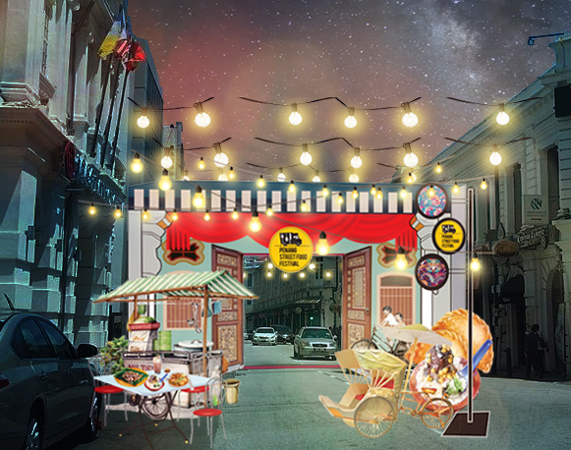
Entrance Arch
Proposed
Main Entrance Décor Concept
  Featuring the façade of Penang Heritage buildings with the traditional food stalls and giant sized famous local street food.

Slide 8







Logo Appearance
Proposed
Sponsors Logo Appearance
  At the entrance arch or stage area.

Slide 9

After Entrance Design
Proposed
Island Decor
  Dimensions: 15’ x 12’
  Quantity: One (1)
  Featuring Penangite favourite street food, more towards Hainanese Peranakan and Jawi Peranakan.

Slide 10
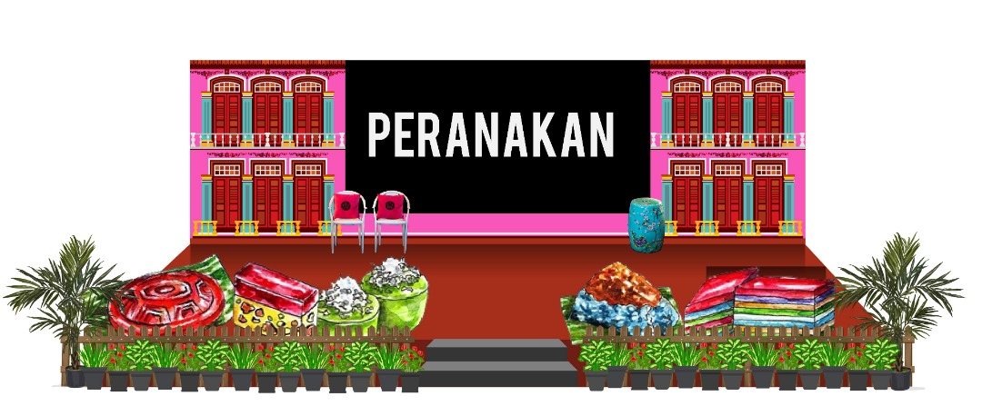
Main Stage
Proposed – Draft
*with or without LED screen
To be finalised

Slide 11
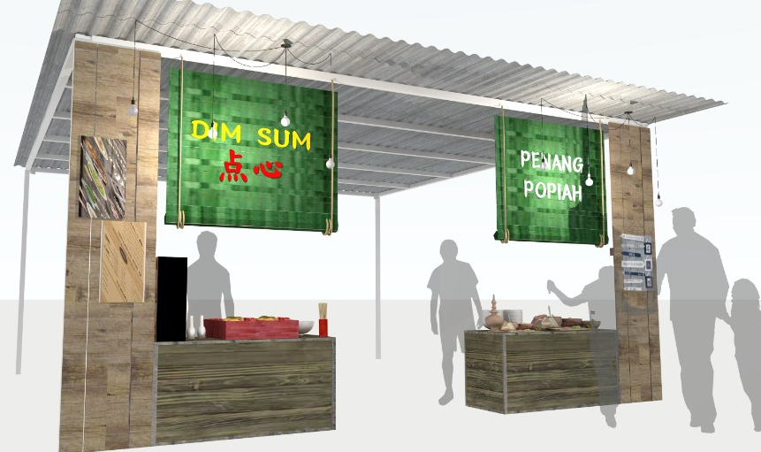
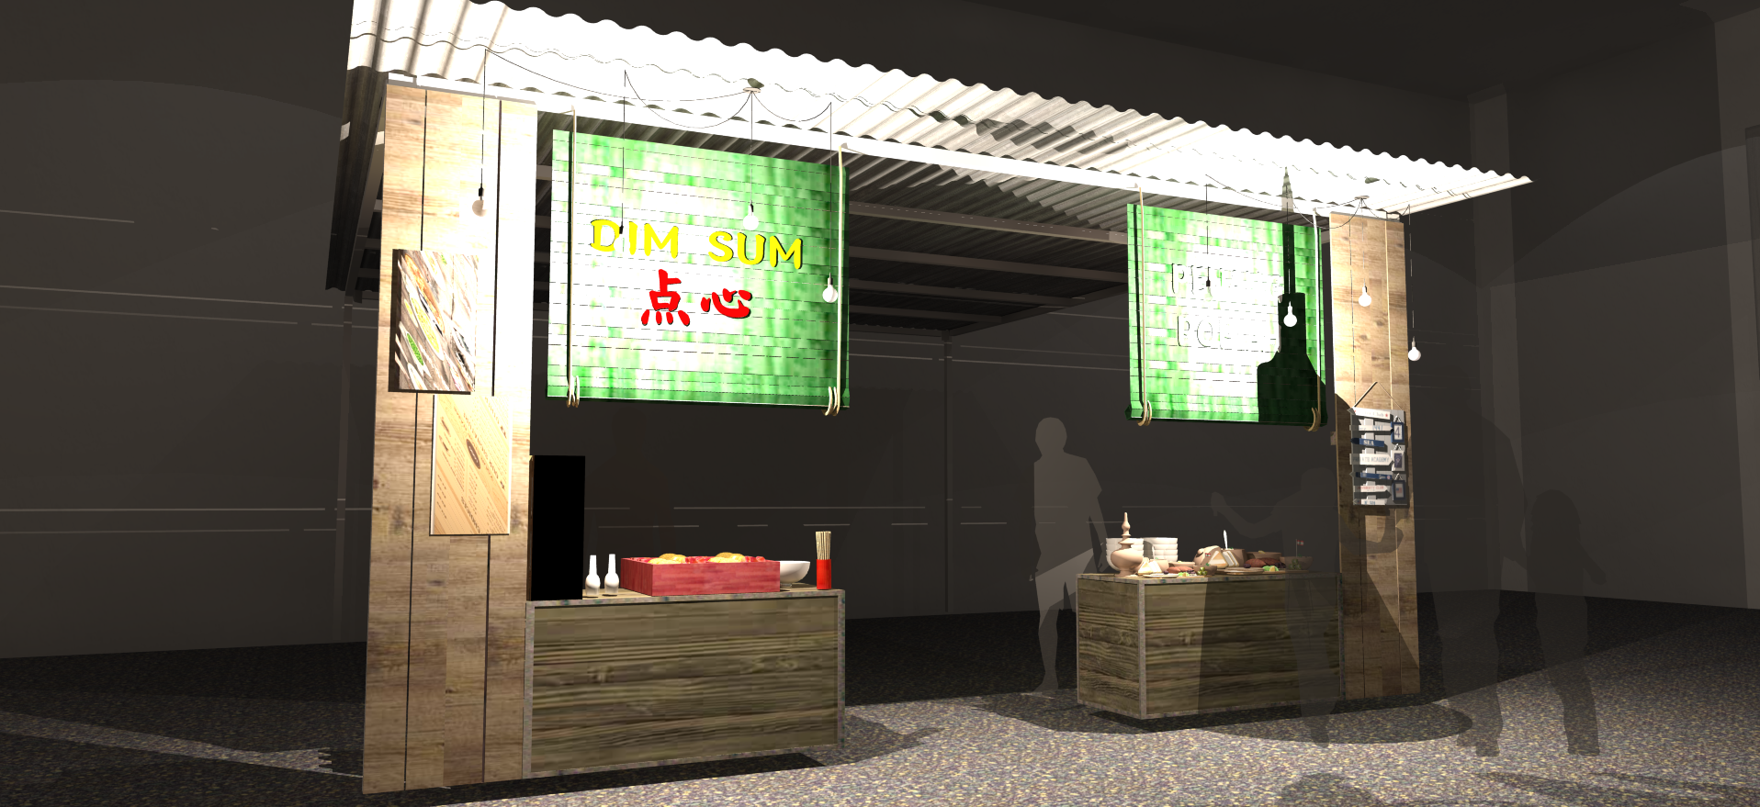
Proposed
Featured Food Stall Set-up
Featured Food Stall Concept
  Dimensions: 20ft x 20ft
  Zinc Tent
  Wooden texture façade with iconic local street food stall sign and light bulbs
  Estimated: 20 stalls

Slide 12
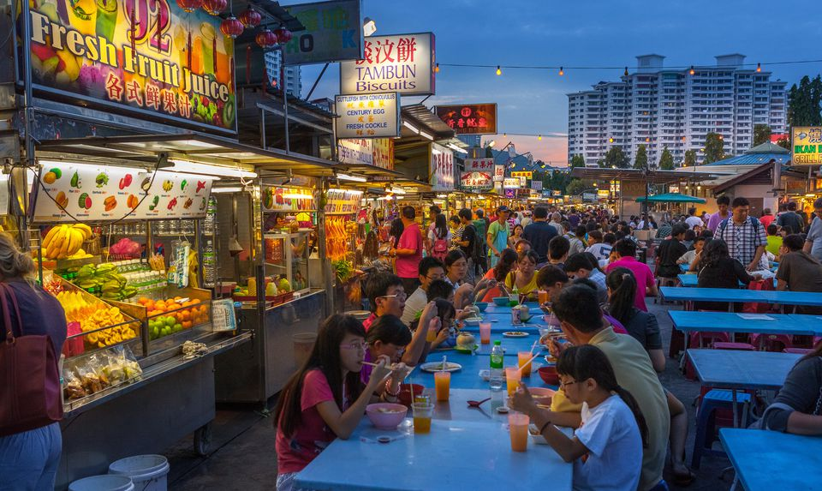
Proposed
Dining Area Set-up
Dining Area
  Dining tables and chairs will be set-up at the other side of the road (opposite the stalls).
  There will be a mixture of round tables and square tables with plastic chairs and stools.
  Cocktail tables will also be scattered around the event area.
  Total seated capacity: 2000 - 2500
  Total standing capacity: 1000

Slide 13
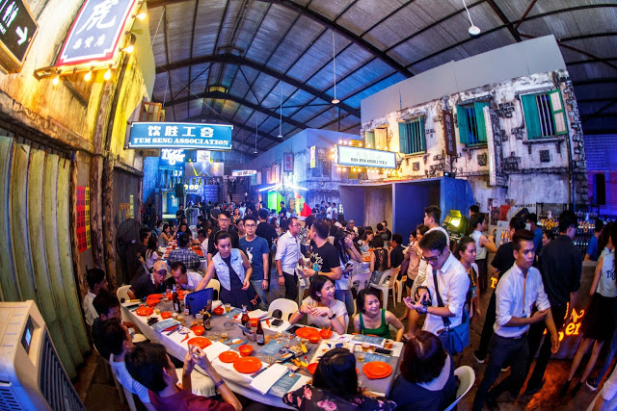
Proposed
Dining Area Set-up
VIP Dining Area
  Designated dining area for VIP after launching ceremony and tour.
  Decoration concept:
  Colonial era busy Penang street with heritage shoplots
  Total seated capacity: 20 – 30

Slide 14
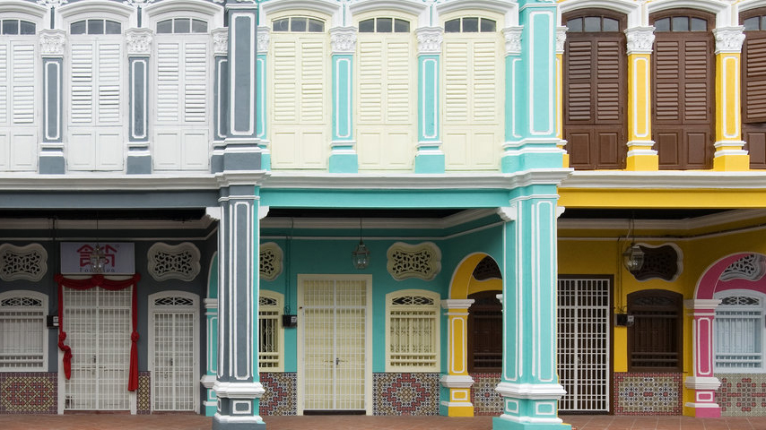
Booth
Proposed-Reference
Standard Stall Décor Concept
  Featuring façade of Penang heritage buildings

Slide 15
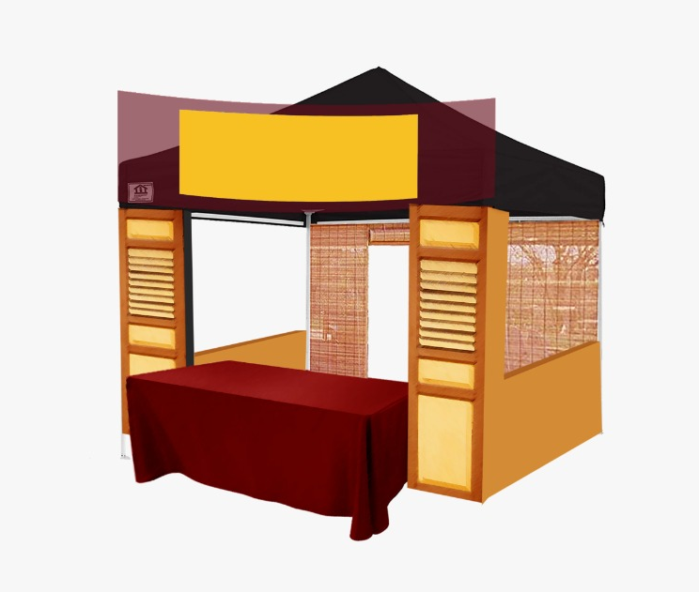
Booth
Proposed
Standard Food Stall Concept
  Dimensions: 10ft x 10ft
  Portable tents / Arabian Tents
  Heritage house façade concept.
  May come in different colours to give a vibrant ambiance.

Slide 16
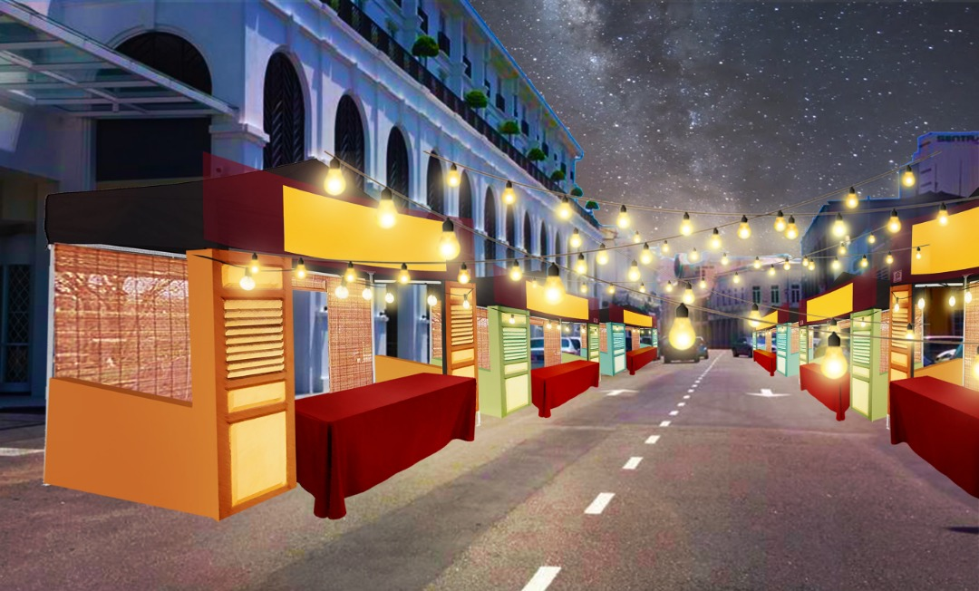



Street Visual
Proposed

Slide 17
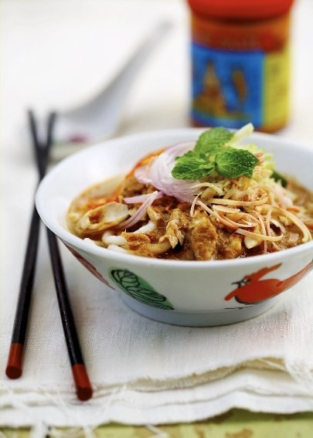
PROPOSED HIGHLIGHT
Aroma Laksa
Why?
  As Penangite, we will definitely agree when someone say that Penang Assam Laksa is the best laksa in the world but there is no harm trying other type of laksa from the surrounding regions.
  Aroma Laksa will gather around different types of laksa stalls, from Penang Assam Laksa to Laksam Kelantan. Each flavour is distinctly aromatic and different. From the sour, red and fiery soups to creamy coconut crème smooth vary, the selection is endless.

Slide 18
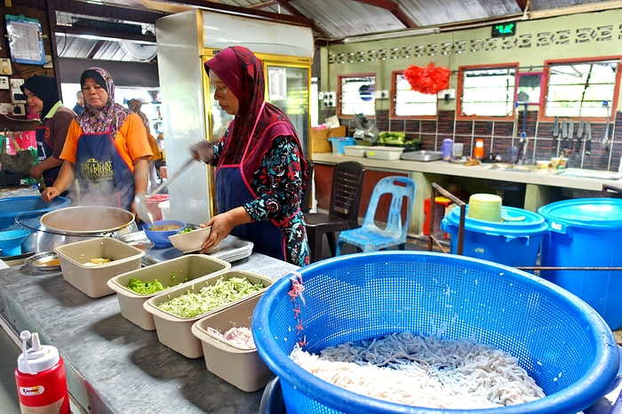
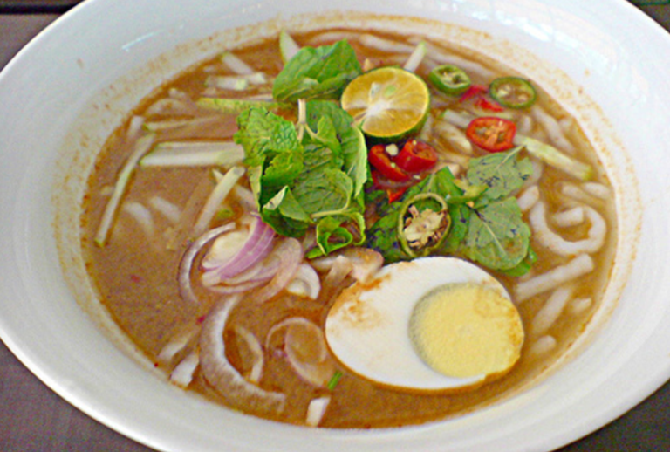
PROPOSED HIGHLIGHT
Aroma Laksa
Laksa Janggus, Balik Pulau
  Stall location: Kampung Perlis, Balik Pulau, Penang.
  Famous Laksa Janggus. One other difference between the Malay and Chinese Asam Laksa is that the Malays add hard-boiled egg to their Laksa as a side, but which the Chinese never do.
  *subject to confirmation / availability

Slide 19
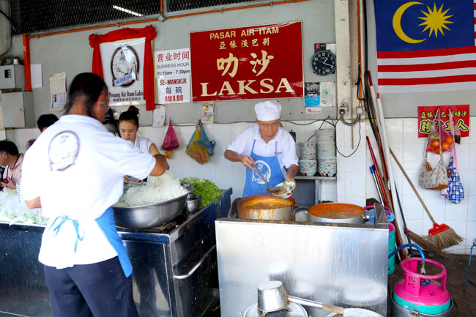
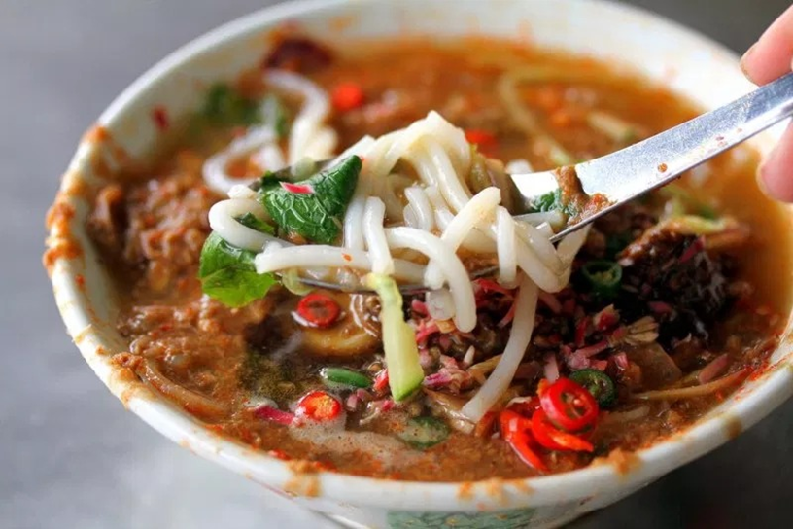
PROPOSED HIGHLIGHT
Aroma Laksa
Pasar Air Itam Laksa
  Stall location: Ayer Itam, Pulau Pinang.
  The famous Penang sisters who run a 73-year-old business selling curry mee and fried bee hoon prove that age is just a number.
  *subject to confirmation / availability

Slide 20
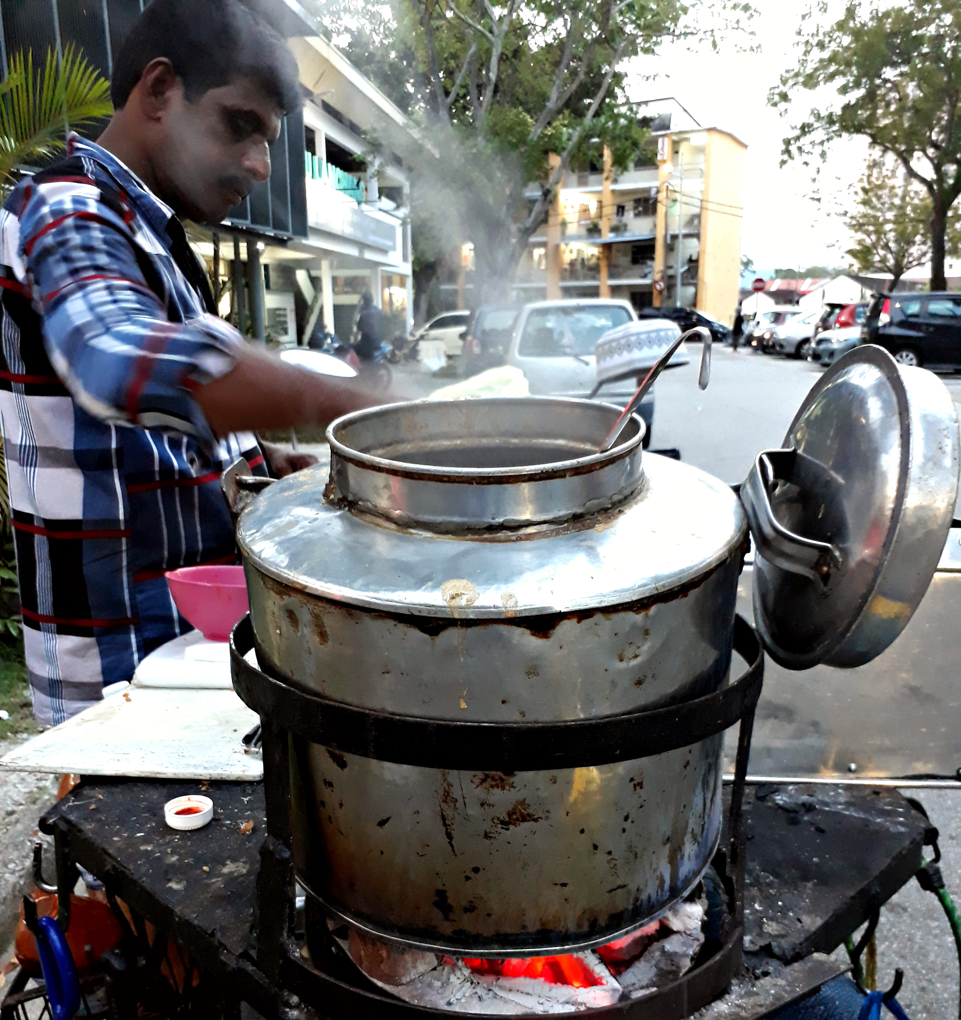
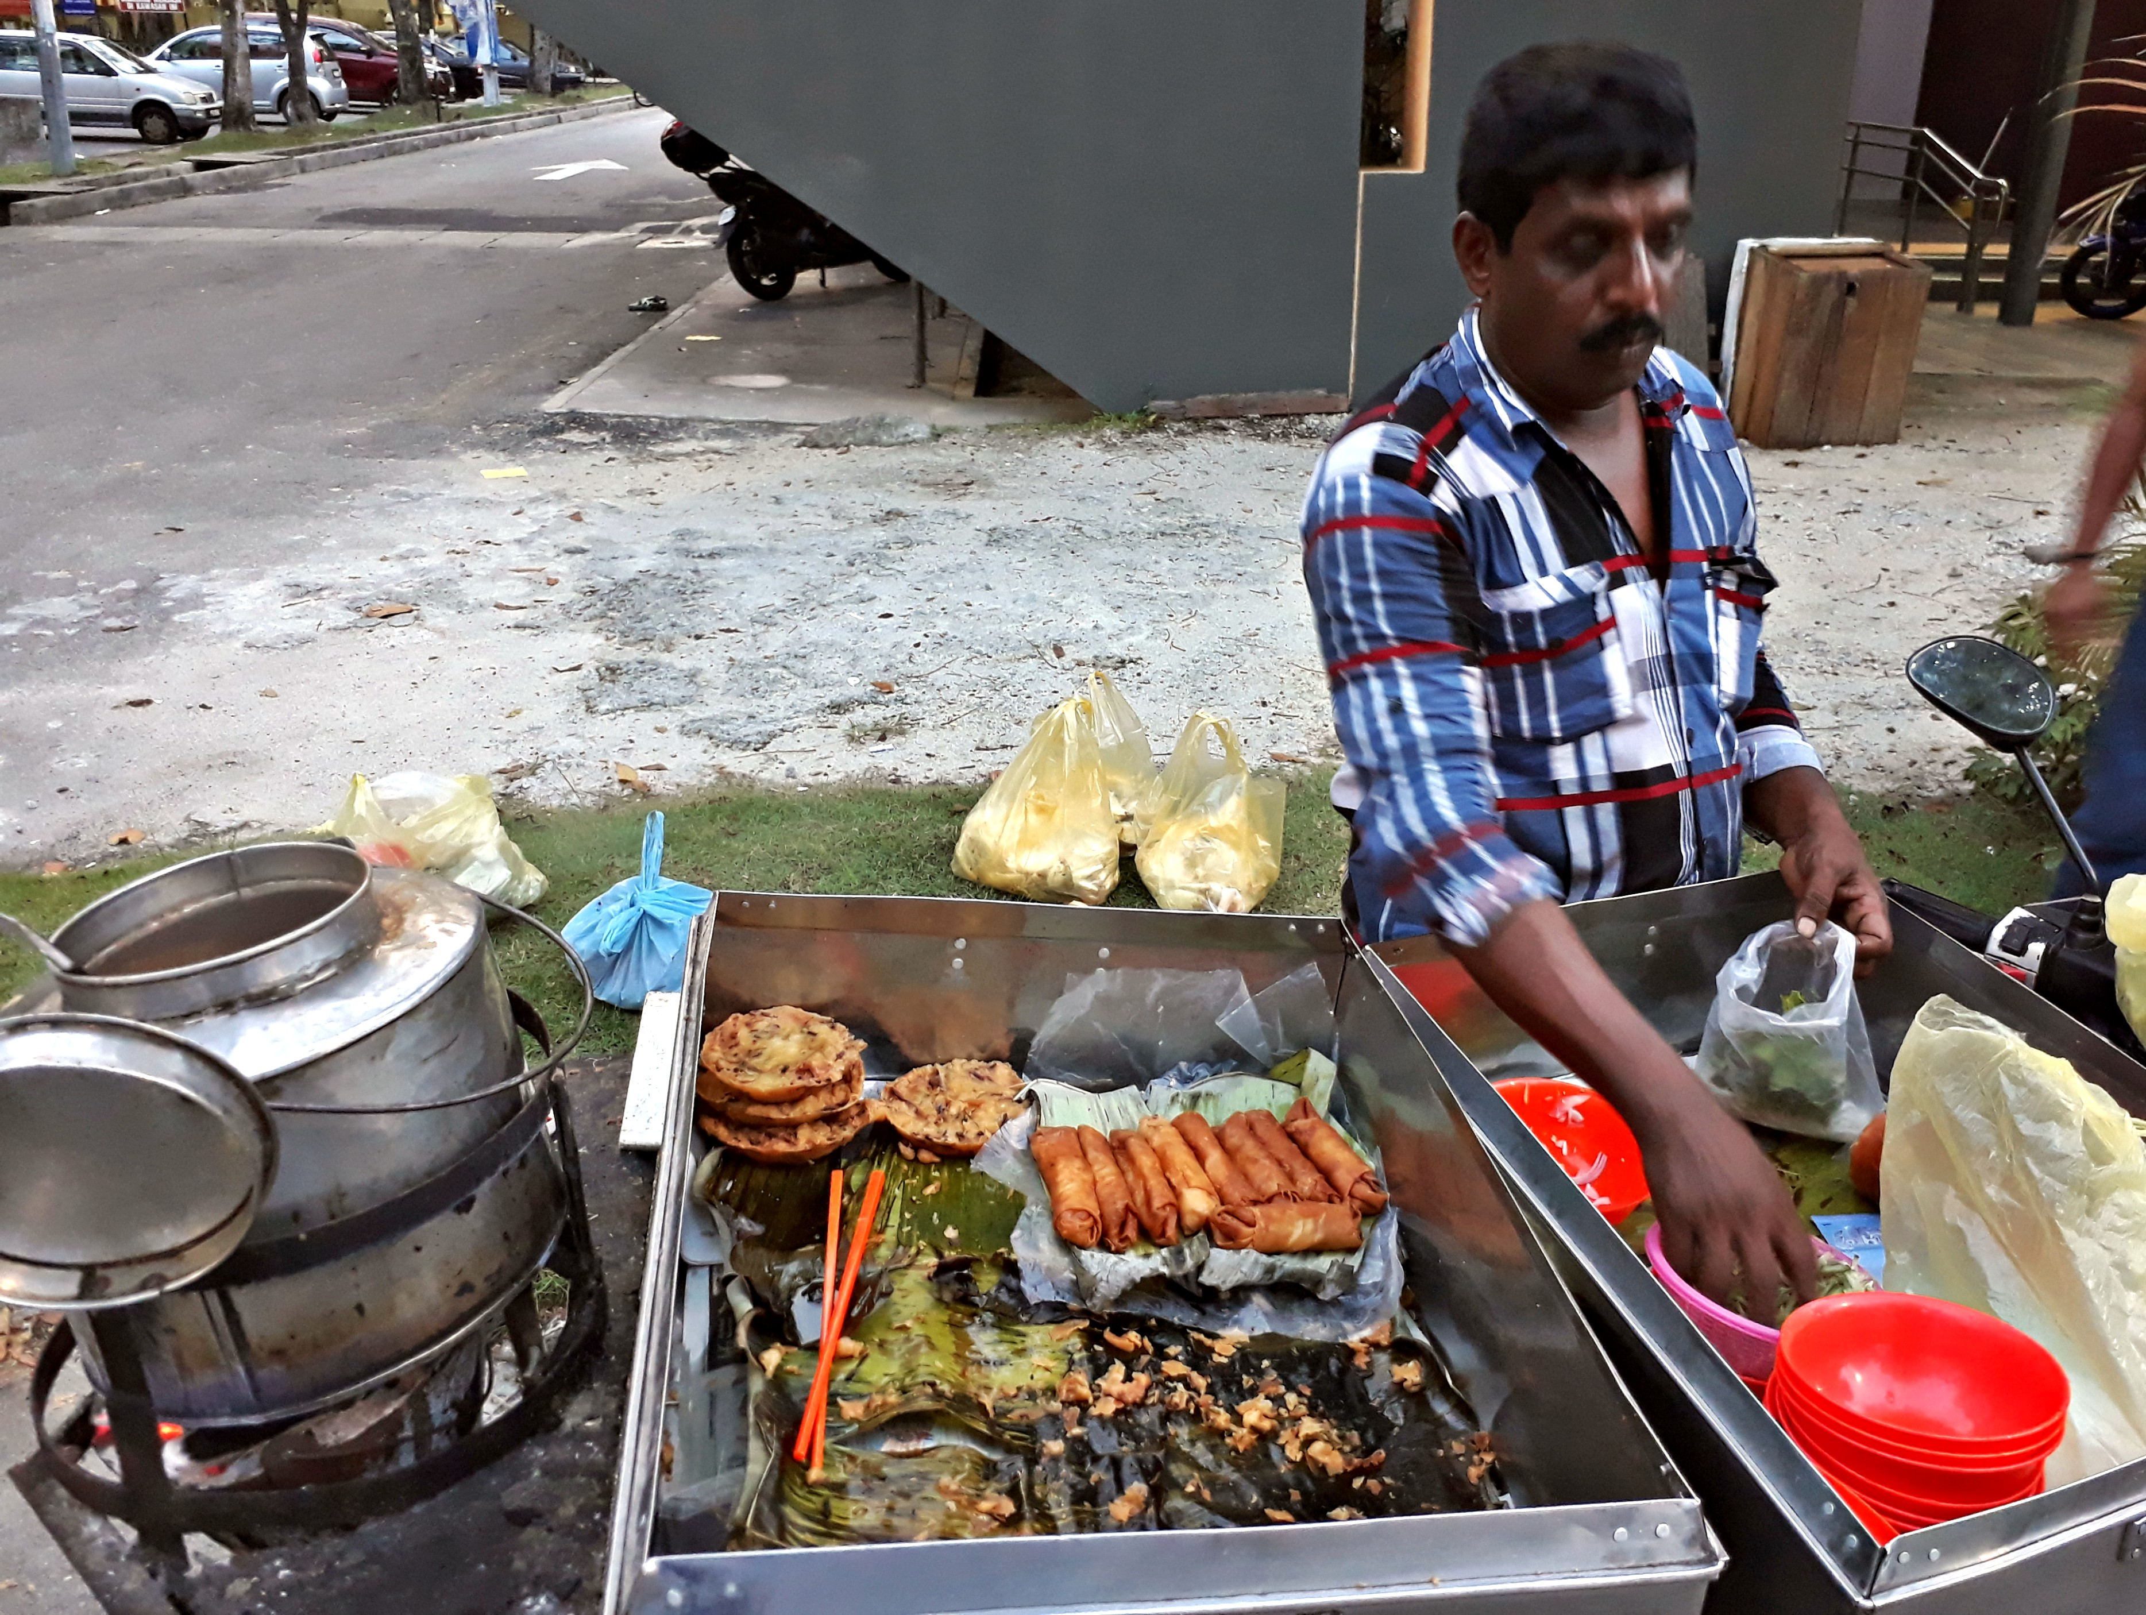
PROPOSED HIGHLIGHT
Aroma Laksa
Hamid & Habibiba Khan’s Mamak Laksa
  Stall location: Batu Lanchang
The mamak laksa is a close cousin of its Malay counterpart: spicier than the Chinese or Nyonya versions, yet, less fishy. Besides the usual garnishes, it also incorporates “cucur” (Tamil fritters) and “popiah goreng” (deep-fried spring rolls) into the dishes. Hard-boiled eggs is also available as an add-on.
  *subject to confirmation / availability

Slide 21
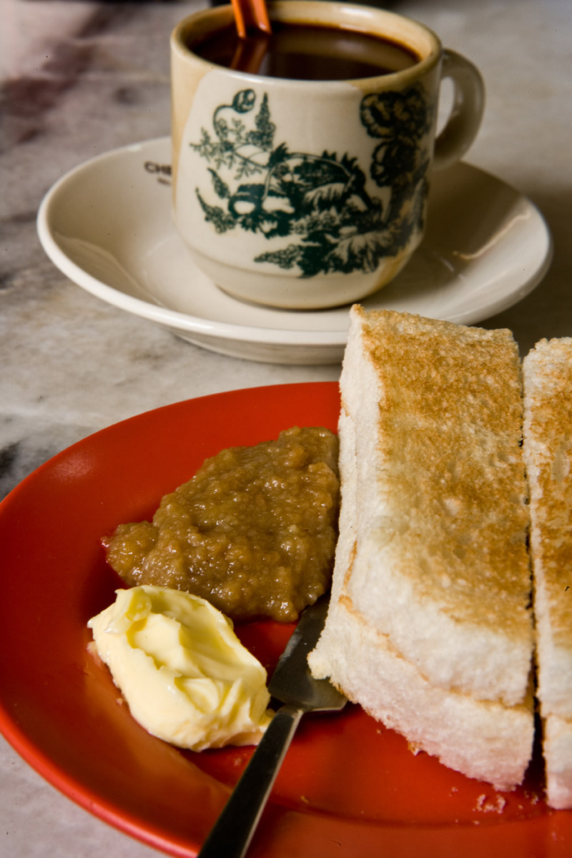
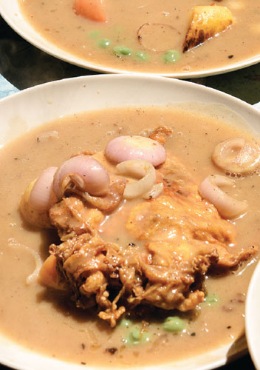
PROPOSED HIGHLIGHT
Peranakan Hainan – 海南风情
Why?
  Malaysian Hainanese is a hodgepodge cuisine, a product of the country’s history as colony (the British controlled much of what is now Malaysia and Singapore from the mid-19th century until 1946) and adopted home of waves of immigrants from Asia and beyond.
  Hainanese cuisine has always had a place in the hearts – and stomachs – of Malaysians, from the staple chicken rice (with Malaysians and Singaporeans hotly debating its origins), to the potato gravy-based chicken chop with roti bakar on the side, hailam char (yellow noodles in white gravy), chicken pot pie, kopi with steamed bread and solf boiled egg.

Slide 22
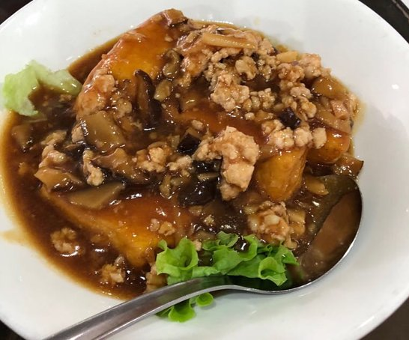
PROPOSED HIGHLIGHT
Peranakan Hainan – 海南风情
747 Restaurant
  Address: 2, Peel Hwy, Georgetown, 10350 George Town, Penang.
  History : The restaurant serves both Chinese and Western style cuisine, but they are more specialized in serving Chinese cuisine. Their signature dishes include Inche Kabin, Chicken Pie etc....but there were not on my order list this time, but I would definitely love to return and try these dishes out in the future. Prices are considered to be fair and reasonable

Slide 23
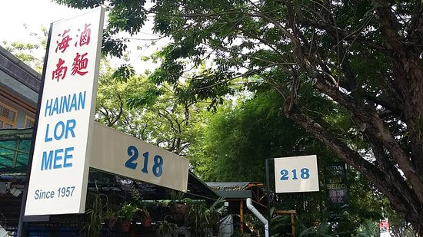
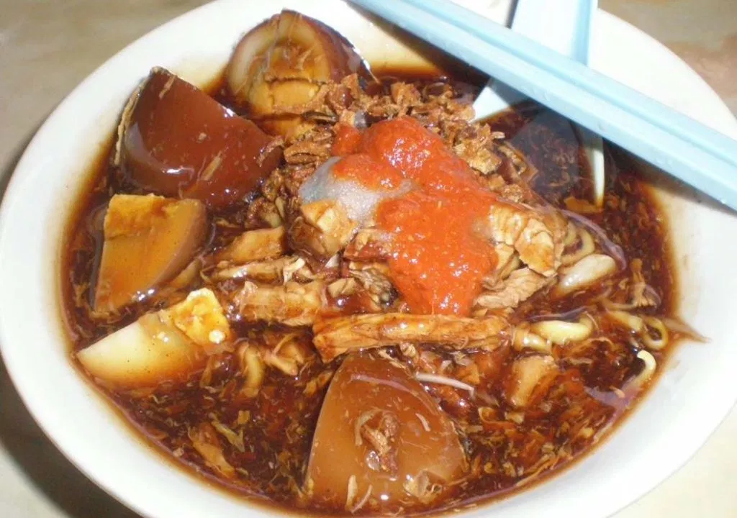
PROPOSED HIGHLIGHT
Peranakan Hainan – 海南风情
218 Hainan Lor Mee
  Address: 218, Jalan Burma | Opposite Wisma Perkeso, Penang, George Town, Penang Island 10350, Malaysia.
  History : 218 is a third- generation business that serves Hainanese Lor Mee. Locally known as Hai Beng Hainan Lor Mee also known as Kuan Yim Theng Lor Mee with a history dated back to 1957.

Slide 24
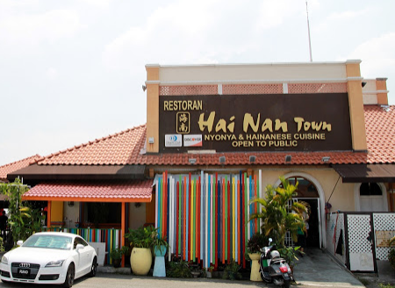
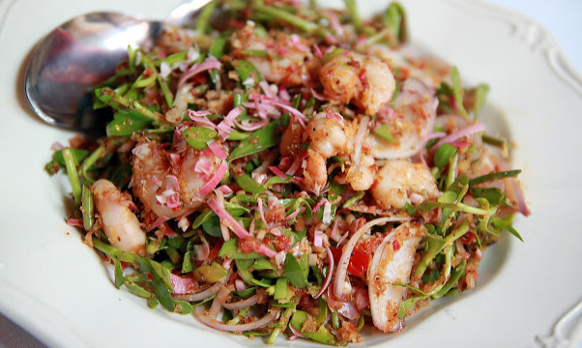
PROPOSED HIGHLIGHT
Peranakan Hainan – 海南风情
Hai Nan Town @ Weld Quay
Address: Tanjung City Marina, 8A, Pengkalan Weld, 10300, Georgetown, Penang.
  History : The Peranakan specialties are of acquired taste and only those with trained palate would know how to appreciate them. One may still find a handful of decent restaurants that serve Nyonya food in Penang but it would not be easy to find that cuts through the novelties and get down to the solid perennial favorites that would not go out of fashion. Hai Nan Town that sits in between the bustling Ferry Terminal and Port Swettenham.

Slide 25
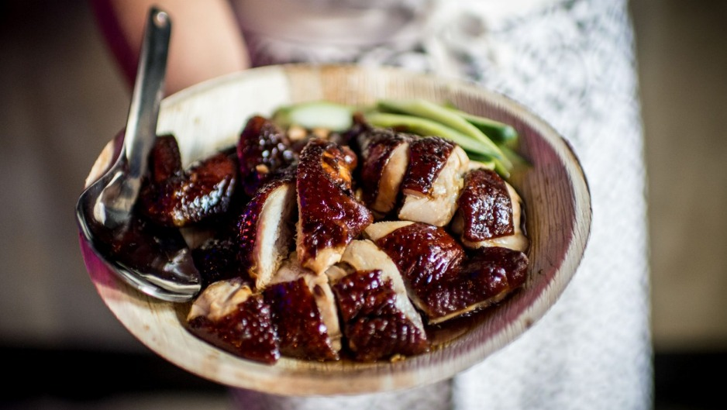
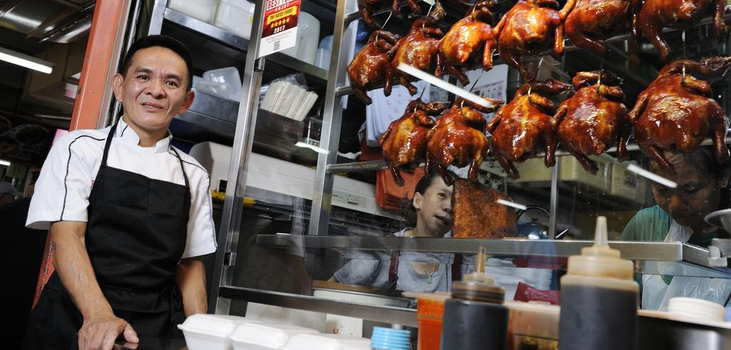
PROPOSED HIGHLIGHT
Featured Stalls
Liao Fan Hawker Chan Chicken Rice
  World’s cheapest Michelin-starred meal
  *subject to confirmation / availability
  *no pork no lard
Notes:
https://danielfooddiary.com/2014/08/16/airitamlaksa/

Slide 26
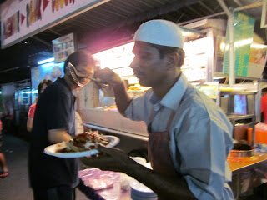
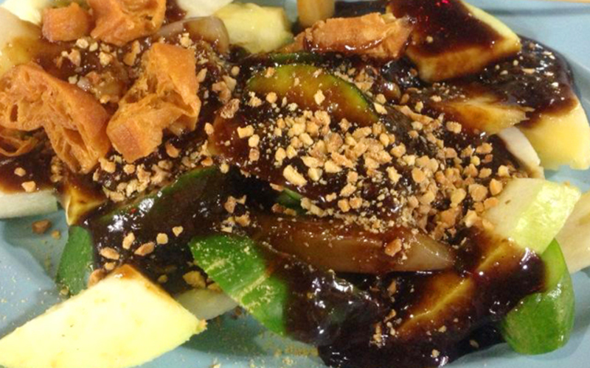
PROPOSED HIGHLIGHT
Featured Stalls
Dancing Rojak Man
  Stall location: Gurney Drive.
  It all starts with a customer picking out from an array of more than twenty mostly cooked ingredients including cucur udang, potatoes, tauhu, keropok, crab meat, cuttlefish, etc. Then Ayub Khan (or 'Ayub Disko Rojak') begins his dance routine as he prepares the pasembur dish by rhythmically cutting up the ingredients. He will even 'sing' Rojak! Rojak! as he does so. Lastly he tops up the dish with cucumber and sengkuang (turnip) shreds, then whirls about as he drizzles spicy peanut sauce over the plateful, ready for the amused waiting customer.
  *subject to confirmation / availability
Notes:
https://danielfooddiary.com/2014/08/16/airitamlaksa/

Slide 27
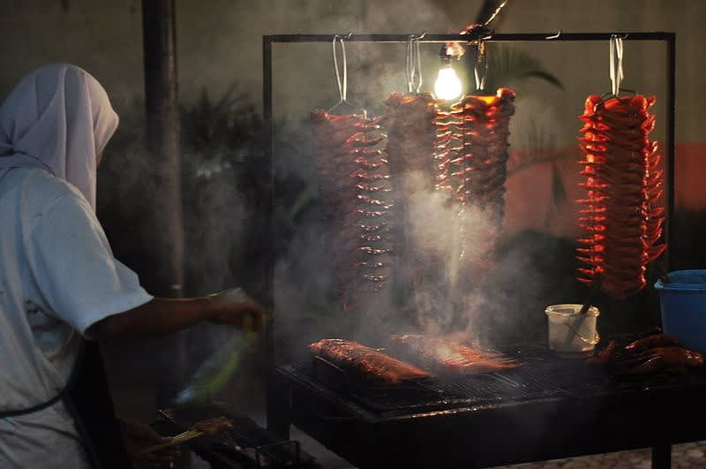
PROPOSED HIGHLIGHT
Featured Stalls
Song River Chicken Wing
  Stall location: Gurney Drive.
  The chicken wings at Song River is well marinated for one night with the owner’s secret recipe. Then, being roasted using charcoal wood to get the crispy textured and golden brown in colour.
  *subject to confirmation / availability
Notes:
https://danielfooddiary.com/2014/08/16/airitamlaksa/

Slide 28
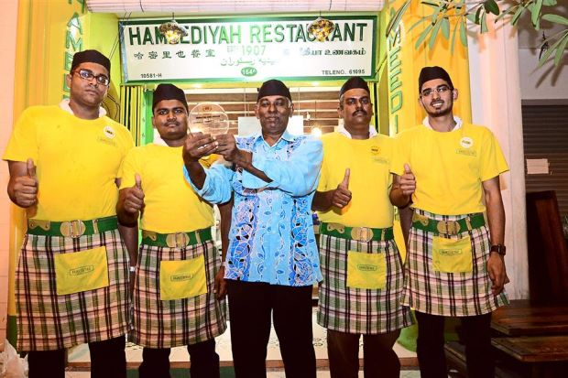
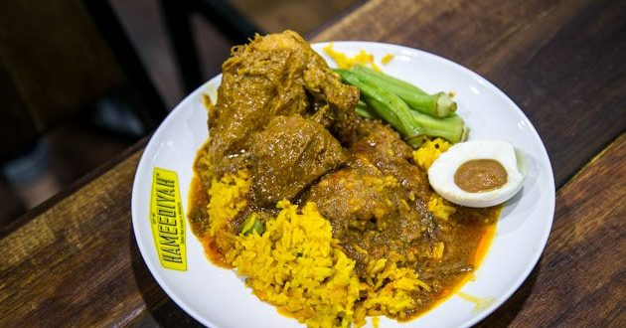
PROPOSED HIGHLIGHT
Featured Stalls
Hameediyah Nasi Kandar
  Hameediyah restaurant first opened its doors to customers in 1907 at lot number 164-A, Campbell street, Penang. The small restaurant, over the years, grew and now has found its way to bigger cities.
  Although the restaurant has been established for more than 100 years ago, Hameediyah still holds true to its colourful and wholesome flavors.
  *subject to confirmation / availability
Notes:
https://danielfooddiary.com/2014/08/16/airitamlaksa/

Slide 29
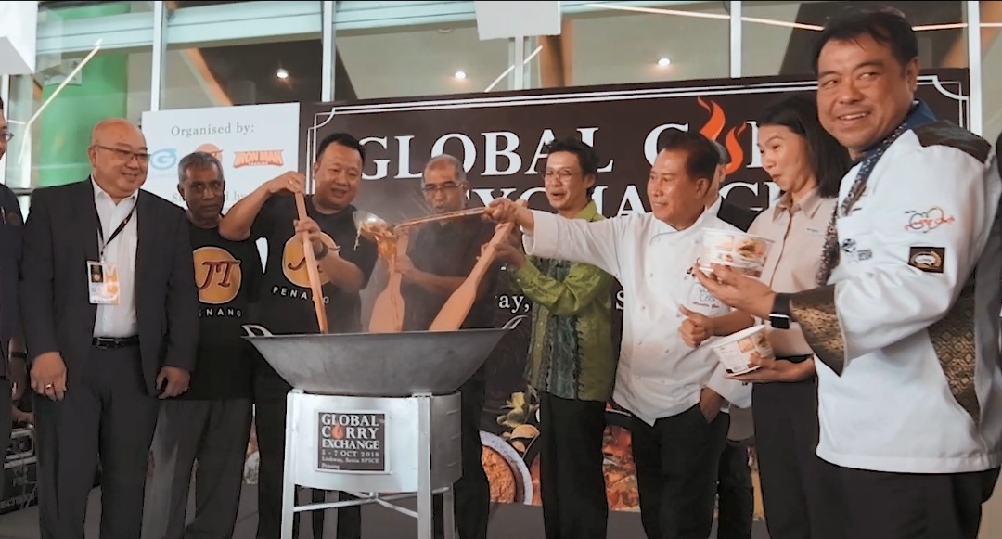
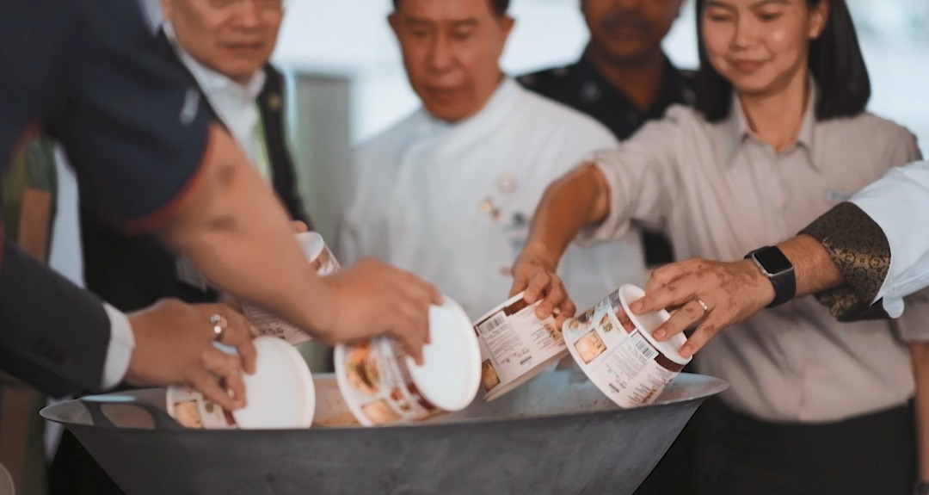
PROPOSED HIGHLIGHT
Opening Gimmick
Cooking of Penang Laksa / Curry
  VIP gather together and cook big wok of Penang laksa / curry.
  - harmonious mixture of different ingredients that able to capture people’s taste buds from all over the world.
  Potential Sponsor: MyKuali (Penang White Curry Mee)
  *subject to confirmation / availability
Notes:
https://www.thestar.com.my/news/nation/2018/06/11/from-the-home-to-the-streets-for-the-country/

Slide 30
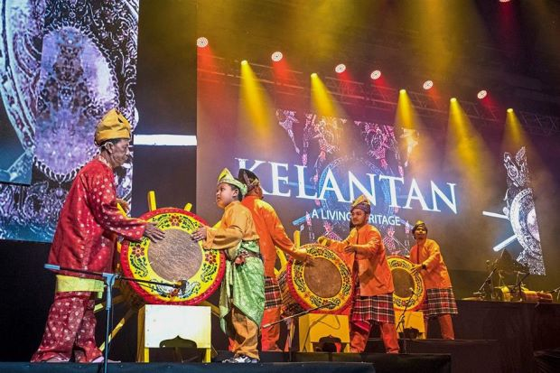
HIGHLIGHT PERFORMANCE
Opening Performance - Rebana Ubi
Rebana ubi is very large cone shaped drum, at least 1 meter high and 70 centimeters in diameter. Rebana ubi ensembles compete with one another in post rice harvest festivals, playing interlocking rhythmic patterns.
Specs: Rebana Ubi Drum (6 pax with 3 drums)
Duration: 10-15 Mins

Slide 31
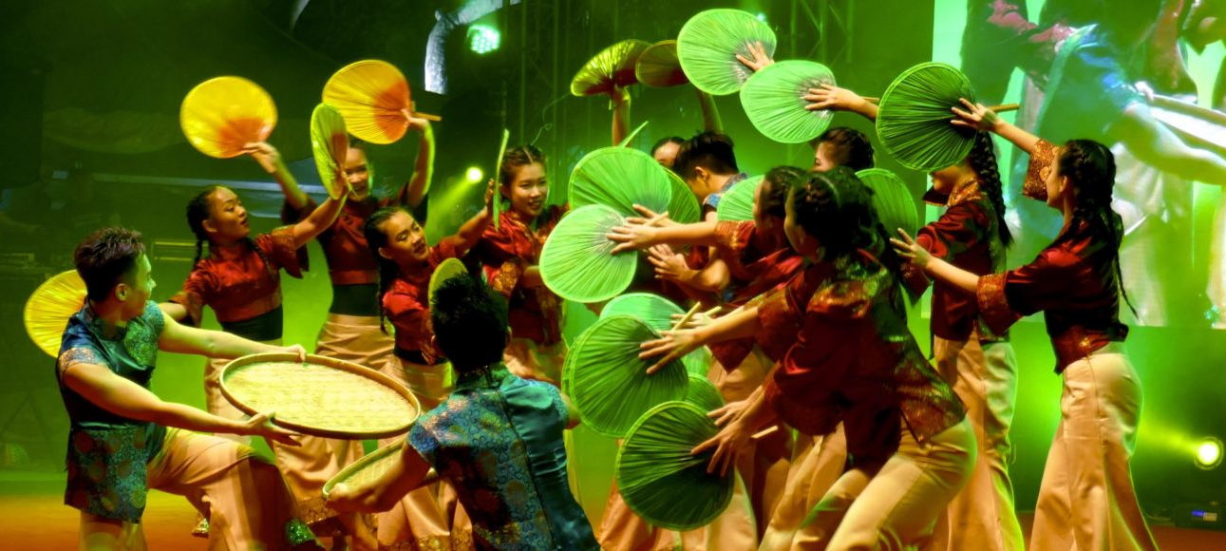
HIGHLIGHT PERFORMANCE
Opening Performance – Taste of Penang
Contemporary dance performance that tells the story of Taste of Penang, different type of food that serves as a foundation of different types of food that serves as a foundation of the harmonious diversity that exists in Penang.
Culture and recipes handed down from generation to generation and shared with everyone regardless of race, colour or creed.
Specs: Penang Euphoria (14 dancers)
Duration: 10-15 Mins

Slide 32
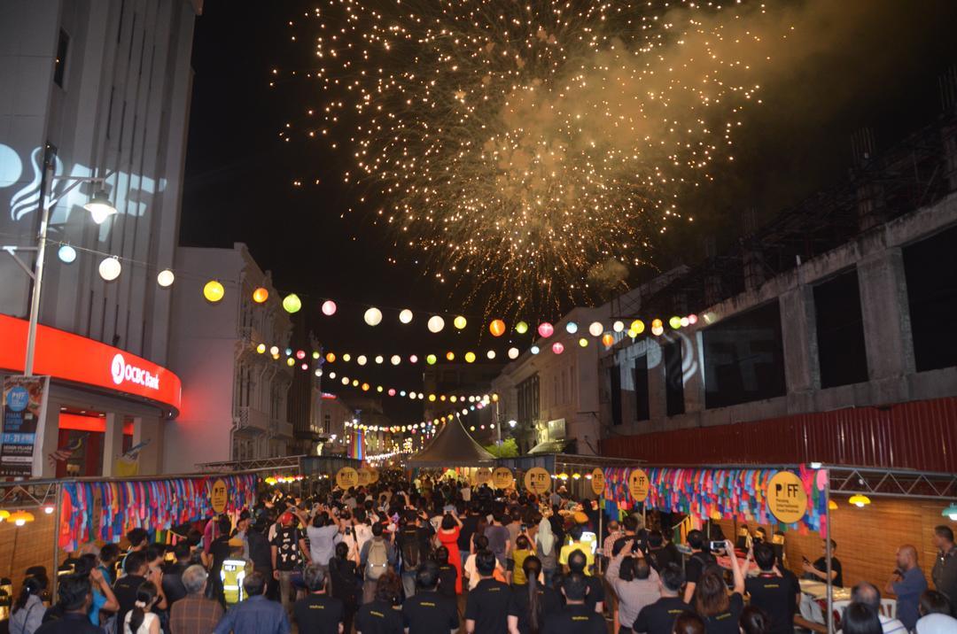
HIGHLIGHT PERFORMANCE
Fireworks Display
Fireworks display that marks the Official Opening of Penang Street Food Festival.
Duration: 3mins

Slide 33
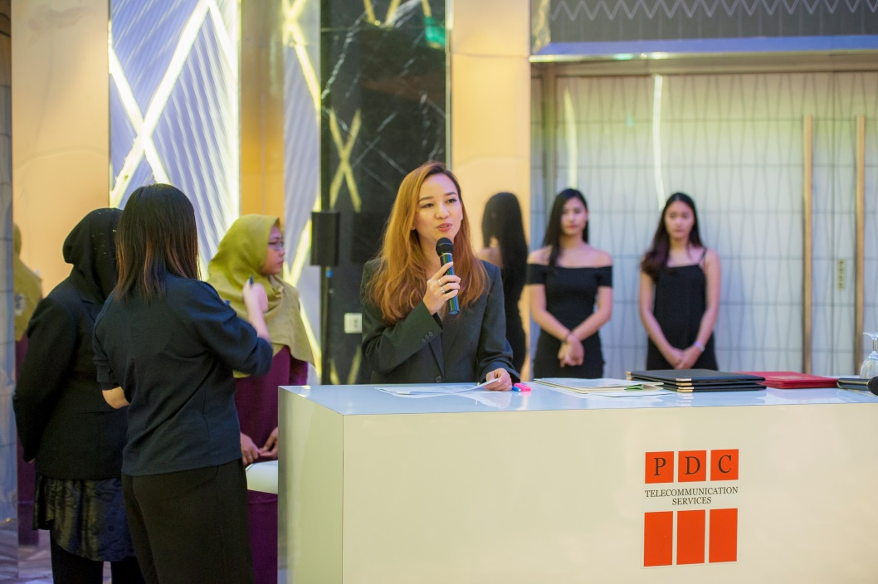
PROPOSED
Emcee
Carolyn Ooi
  Why?
  A natural on stage, with her down to earth personality, she is able to communicate with people of all age and background.
  She is able to host events, launchings, government events, dinner, roadshows, carnivals, forums, symposiums and sports events.
  Duration: Full Duration of Event
  Language Proficiency: English, Bahasa Malaysia

Slide 34
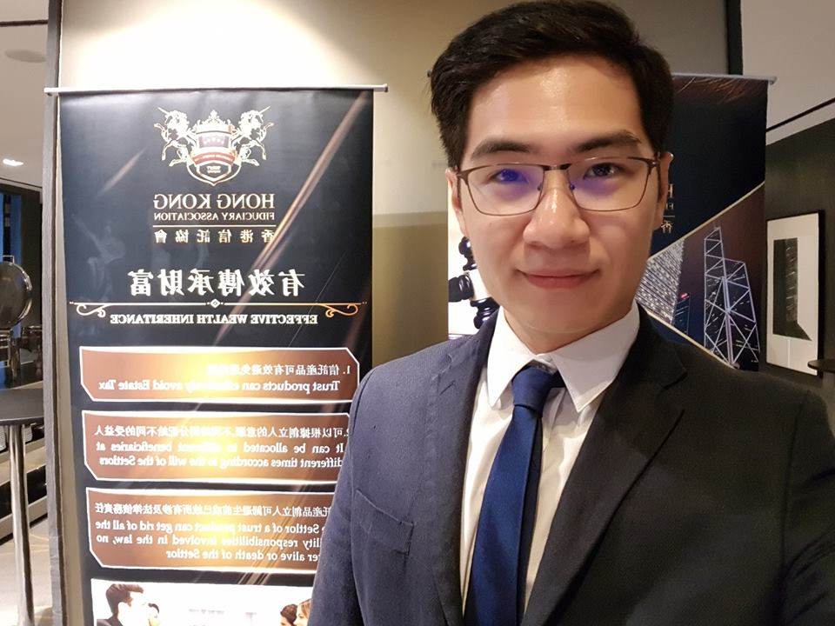
PROPOSED
Emcee
Sebastian Kwan
  Why?
  Young and emerging professional emcee. Sebastian, who based in Penang, is now emceeing for corporate and private events all around Malaysia.
  He is experienced in handling all sort of corporate and government (state) events.
  Duration: Full Duration of Event
  Language Proficiency: English, Bahasa Malaysia, Mandarin

Slide 35
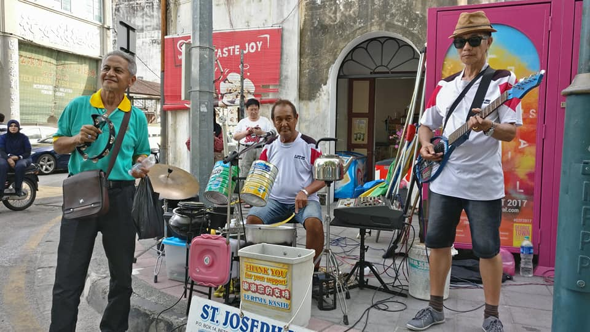
Proposed
Street Performance
  Penang Buskers
  Specs: Using recycle item like basket and tin to
  create music
Notes:
https://www.thestar.com.my/news/nation/2018/06/11/from-the-home-to-the-streets-for-the-country/

Slide 36
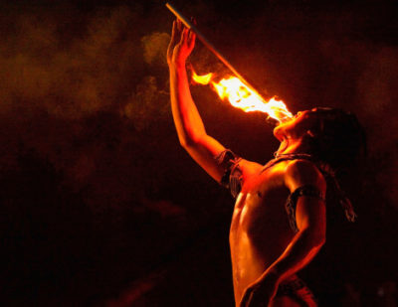
Proposed
Street Performance
Fire Eater
Fire eating is the act of putting a flaming
object into the mouth and extinguishing it.
This excellent show can catches the eyes of visitors.
Notes:
https://www.thestar.com.my/news/nation/2018/06/11/from-the-home-to-the-streets-for-the-country/

Slide 37

Proposed
Mini Stage
Mini Stage
  Simple, small stage will be set up to fill the street with live music and street performance.
  To be placed at:
  1. Jalan Gereja
  2. Bishop Street

Slide 38
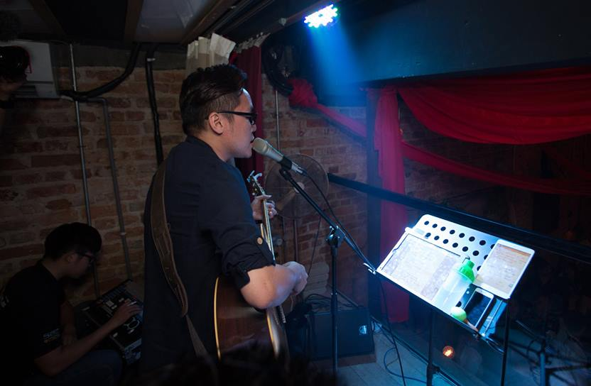
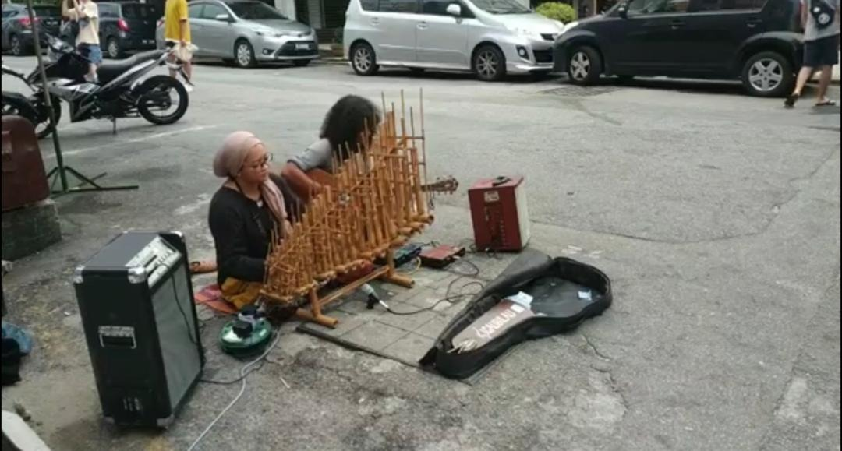
Proposed
Street Performance
  Live Street Performance
  Local band (street / folks) performing live throughout the night at mini stage with simple AV system.

Slide 39
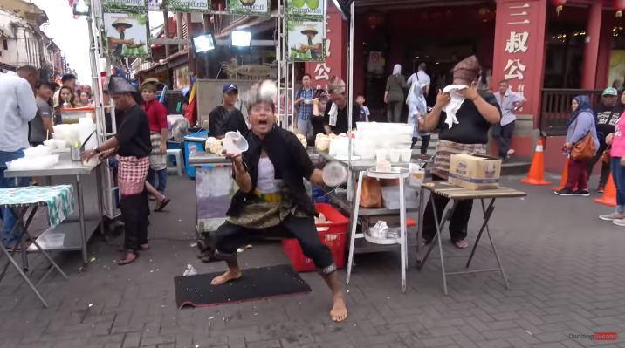
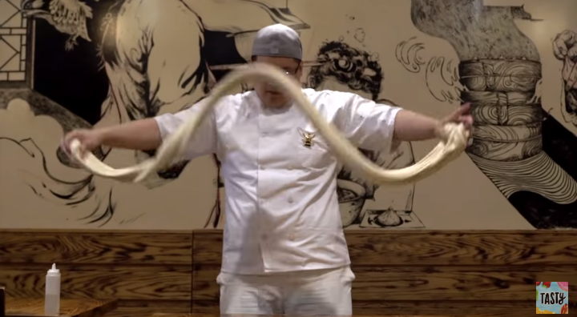
Proposed
Street Performance
  Coconut nut dance street performance.
  Noodle Performance
Notes:
https://www.youtube.com/watch?v=uspWbI6Dk7s or
https://www.youtube.com/watch?v=8X3BrLKvC1I

Slide 40

Proposed
Street Performance
Magic Show
Notes:
https://www.youtube.com/watch?v=J-Jb_3lzhek

Slide 41

Proposed
Street Performance
Teh Tarik Art Performance / Competition
Notes:
https://www.youtube.com/watch?v=J-Jb_3lzhek

Slide 42


Proposed
Street Performance
Roti Canai Flipping Performance
Notes:
https://www.youtube.com/watch?v=J-Jb_3lzhek

Slide 43

PROPOSED STREET FOOD
Just to name a few….
This document is an intellectual property of Goche Corporation Sdn Bhd. Any distribution and/or duplication without consent is strictly prohibited.

Slide 44


Proposed
Street Food
Penang Road Famous Teochew Cendol
  Address: Lebuh Keng Kwee (at Penang Rd) 10000 George Town, Pulau Pinang Malaysia.
  History : Penang Road Famous Teochew Chendul boast of a history dating back to 1936, when founder Mr Tan started the business of selling the simple dessert to support his family. The taste of his freshly made chendol not only found and remains in favor with the local palates, but slowly gained recognition from overseas fans as well, leading to its continued expansion of a few outlets, no doubt banking on the incredible reputation it has built up over the years. The business is still in the hands of the family, now managed by the third generation.
Notes:
https://foursquare.com/v/penang-road-famous-teochew-chendul-tan/4bca9176937ca593f841a892

Slide 45


Proposed
Street Food
Jalan Kuantan Curry Mee
  Address: 58, Jalan Kuantan, George Town, 10150 George Town, Pulau Pinang.
  History : Tan Teong Ban aka Ah Ban, 47, is the second-generation of the family which sells their Penang-style white curry noodles in Kuantan Road and Terengganu Road in Penang, and OUG in Kuala Lumpur. This stall at Kuantan Road is their most famous outlet and only opens in the morning Tue-Sun.
Notes:
http://hirogosomewhere.com/2018/02/15/curry-mee-jalan-kuantan-curry-mee-ah-ban-curry-mee/

Slide 46


Proposed
Street Food
Air Itam Sister Curry Mee
  Address: 612 T, Jalan Air Itam, Pekan Ayer Itam, 11500 Ayer Itam, Pulau Pinang.
  History : The famous Penang sisters who run a 73-year-old business selling curry mee and fried bee hoon prove that age is just a number.
Notes:
https://www.malaymail.com/news/eat-drink/2019/02/26/the-curry-mee-sisters-spicing-up-penang/1726935

Slide 47


Proposed
Street Food
888 Hokkien Mee
  Address: 67-A, Lebuh Presgrave, George Town, 10300 George Town, Pulau Pinang.
  History : 888 Hokkien Mee crowned as one of the ‘The Best Hokkien Mee’ in Penang in a competition a few years back and gains fame and popularity for its trusty bowl of Hokkien Mee.
Notes:
https://www.choiyen.com/888-hokkien-mee-bayan-baru-penang/

Slide 48


Proposed
Street Food
Fried Oyster - Lebuh Carnarvon, Penang
  Address: 4, Jelutong Highway, Taman Jelutong, 11600 George Town, Penang.
  History : The fried oyster is the best in town. The omelette itself was so good even the oysters kinda became a bit of a second thought. The texture had a nice blend of crispiness with the familiar consistency of egg, and none of those sticky gooey half cooked starch that you sometimes find in less superior oh chien.

Slide 49


Proposed
Street Food
Moh Teng Pheow Nyonya Kuih
  Address: Jalan Masjid (Off Chulia Street), 10200, Georgetown, Penang.
  History : The place is famous for dishing out fresh home-made Nyonya Kuih. The 60 year old- Kuih Factory had a minor refurbishment recently, turning a corner of the place into a cozy, presentable "canteen". Step in the place and you will be welcomed by a warm, homely atmosphere with retro bric-a-brac. The entrance may seem unappealing, walk in and you will find yourself in a living museum, demonstrating the entire kuih-making process using utensils from the past. The retro vibes of the cafe, are boosted by the mismatched bits of antiques and vintage pieces. Moh Teng Pheow offers a small menu, but the team is dedicated to offer their best.

Slide 50


Proposed
Street Food
Macallum Street Hock Seng Rojak
  Address: Cecil Street Ghaut, Georgetown, Penang.
  History : This 30-year-old rojak stall is regarded by many of its fans as the No. 1 rojak stall in Penang! Started by Mr Khor Hock Seng in 1986 after a carpenter shop he worked at closed down, he concocted the thick, caramelly rojak sauce which is thicker (and MUCH, much sweeter) than any I’d ever encountered either in Penang or anywhere in the world!

Slide 51


Proposed
Street Food
Ali Nasi Lemak Daun Pisang
  Address: Sri Weld Food Court, Beach St, George Town, 10300 George Town, Pulau Pinang.
  History : Known to be the best nasi lemak in Penang, Ali Nasi Lemak truly lives up to its name. The crowd never stops since the beginning of their operation. You can see how they prepare your favourite nasi lemak from scratch. Rows of fragrant steamy rice waiting for the sambal to be poured over. you’ll get an eyegasm just by looking at it. They have different flavours to choose from, but we suggest you to stick with the classic.

Slide 52


Proposed
Street Food
Ravi’s Apom Manis
  Address: Kedai Kopi Swee Kong, Solok Moulmein, Pulau Tikus , 10350 , Georgetown, Penang.
  History : Finding an apom seller in Penang with an eighty-year-old history is a great joy, but how about an apom seller also that uses charcoal flame instead of gas and makes his fluffy apoms in a claypot? This is definitely priceless. Ravi inherited an apom manis ( sweet crepes) business from his father and now runs it with his brother (shown in the picture) from a little corner in a kopitiam called Swee Kong located at the junction of Jalan Burma with Solok Moulmein.

Slide 53

Fun fair
This document is an intellectual property of Goche Corporation Sdn Bhd. Any distribution and/or duplication without consent is strictly prohibited.

Slide 54

Proposed
Fun Fair
Old Penang Amusement Park Revived
  Fun Game Stalls x 10 stalls
  Magic and balloon clown shows
  Live Screening
  Popcorns & Candyfloss Cart
  Ais Kepal Stall
  Ice-cream Potong Stall

Slide 55


Proposed
Fun Fair

Slide 56


Crew Costume

Slide 57

Advertising & Promotions
This document is an intellectual property of Goche Corporation Sdn Bhd. Any distribution and/or duplication without consent is strictly prohibited.

Slide 58

Advertising & Promotion
Roadshow
Why?
On ground activation / promotion to the local folks in events around town.
i. Penang Bridge International Marathon
ii. Occupy Beach Street

Slide 59

Advertising & Promotion
Free Shuttle
Why?
Penang Street Food Festival will be held on the same weekend as Penang Bridge International Marathon 2019 and George Town Literary Festival.
Free shuttle from Queensbay Mall or hotels to event venue will reduce vehicles at the event venue, save hassle to look for car parks and economical as well.
*to look for sponsors (hotels or transportation company) to host

Slide 60

Advertising & Promotion
Bus Sticker
If quota is available from the Penang State Government.

Slide 61

Advertising & Promotion
Road Side Streamers
About 100pcs (will increase to 150 to 200 if possible).
Covering the event area and its close proximity, high desity town area in both island and mainland.

Slide 62

Advertising & Promotion
Billboard
If quota is available from the Penang State Government.

Slide 63

Social Media
Set-up stand alone account for Penang Street Food Festival.
Beside stand alone ads campaign, will ride on other platform to promote such as Penang International Food Festival’s page, Penang Global Tourism’s Page, MOTAC and etc.

Slide 64



Green Initiative
Go Green
Participating stalls will be encouraged to use paper bags, straws, plates, bowl or banana leaf.
No single use plastic.
Visitors will be encouraged to bring their own tumblers.

Slide 65

This document is an intellectual property of Goche Corporation Sdn Bhd. Any distribution and/or duplication without consent is strictly prohibited.

Slide 66
Thank you!
Event Concept & Proposal by Goche Corporation Sdn Bhd exclusively for Penang Global Tourism.
For more info, please contact Ms Yvonne Toh (yvonne@gochecorp.com)
This document is an intellectual property of Goche Corporation Sdn Bhd. Any distribution and/or duplication without consent is strictly prohibited.

Slide 67


Slide 68


Slide 69


Slide 70


Slide 71


Slide 72


Slide 73


Slide 74


Past Event – Global Curry Exchange

Slide 75

Past Event – Global Curry Exchange

Slide 76


Past Event – Global Curry Exchange

Slide 77


Slide 78


Slide 79


Slide 80


Slide 81


Slide 82


Slide 83


Slide 84


