Slide 1
Penang Media FAM Tour Clipping Report
No | Media | Media Style | Market | Clipping Link | Size (cm) | PR Value (CNY)
1 | Poco | Online | National | http://travel.poco.cn/special_topic/?topic_id=10327 |  | 150,000
2 | QYER | Online | National | http://bbs.qyer.com/viewthread.php?tid=655472 |  | 150,000
3 | BQ 北京青年周刊 | Magazine | Beijing | Clipping Received | 2P | 200,000
4 | Beijing News 新京报 | Newspaper | Beijing | http://www.bjnews.com.cn/lifestyle/2012/07/25/212497.html | 3/4P | 120,000
5 | Beijing Times 京华时报 | Newspaper | Beijing | http://epaper.jinghua.cn/html/2012-08/08/content_903215.htm | 1/2P | 100,000
6 | Dushi Kuaibo 都市快报 | Magazine | Hangzhou | http://hzdaily.hangzhou.com.cn/dskb/html/2012-08/09/content_1321342.htm | 3/4P | 120,000
Total |  |  |  |  |  | 840,000

Slide 2
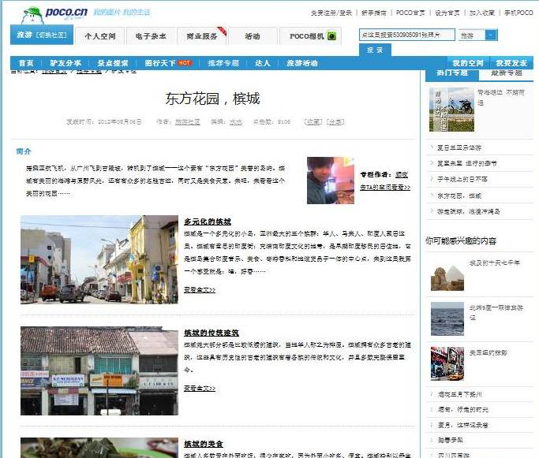
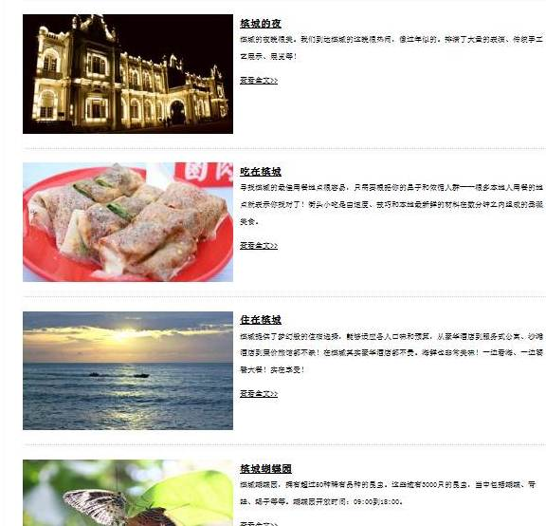
Clipping Samples – www.poco.com

Slide 3
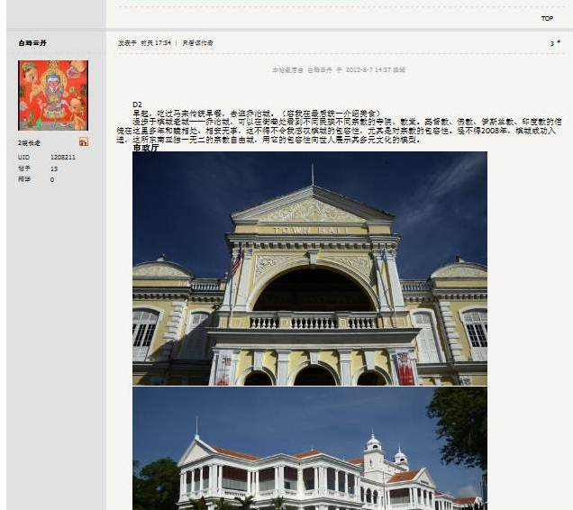
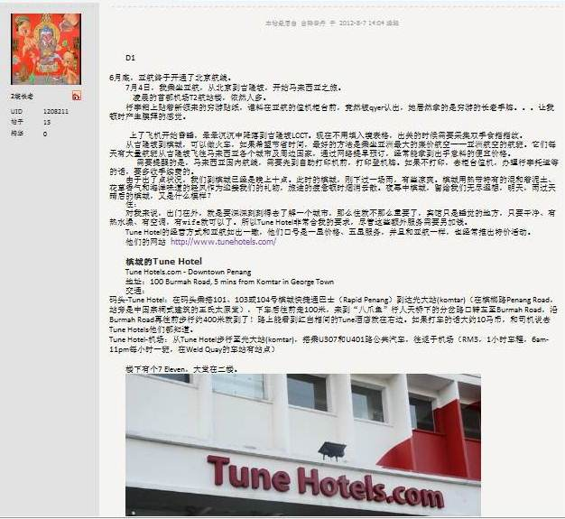
Clipping Samples – www.qyer.com

Slide 4
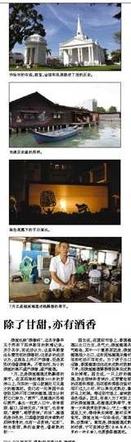
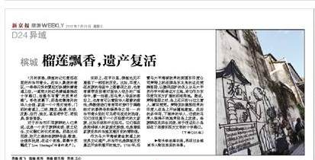
Clipping Samples – Beijing News
Notes:
Objective/Target Consumer define/Habit/Rationale (cost? Coverage and Spots?)

Slide 5
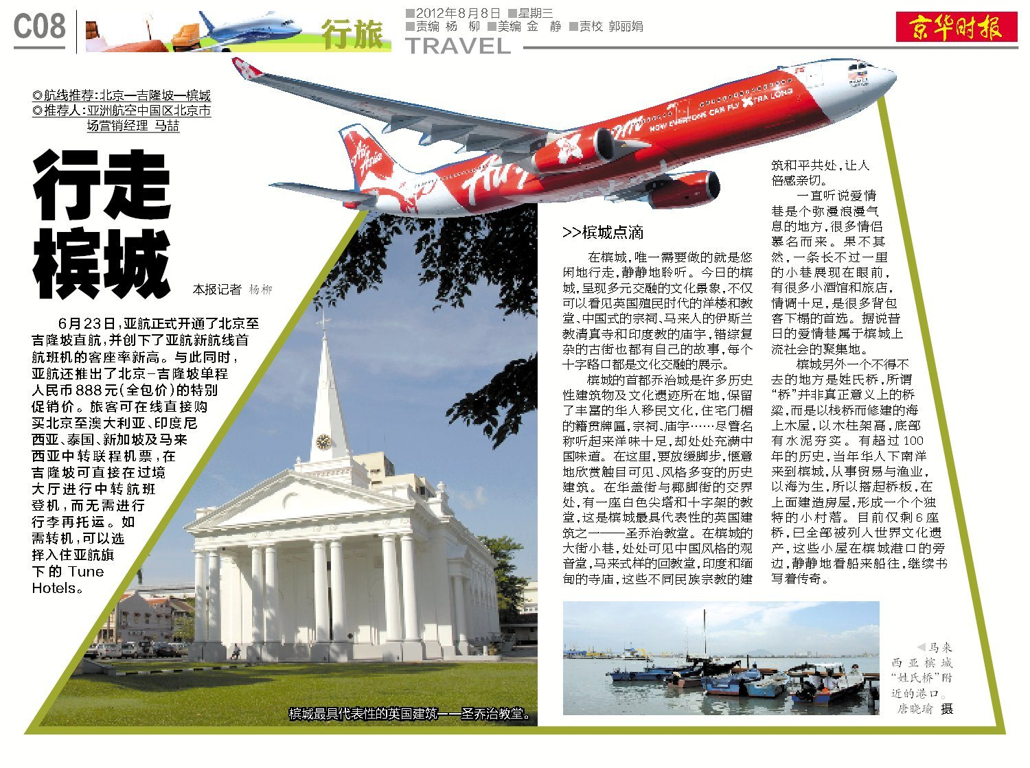
Clipping Samples – Beijing Times
Notes:
Objective/Target Consumer define/Habit/Rationale (cost? Coverage and Spots?)

Slide 6
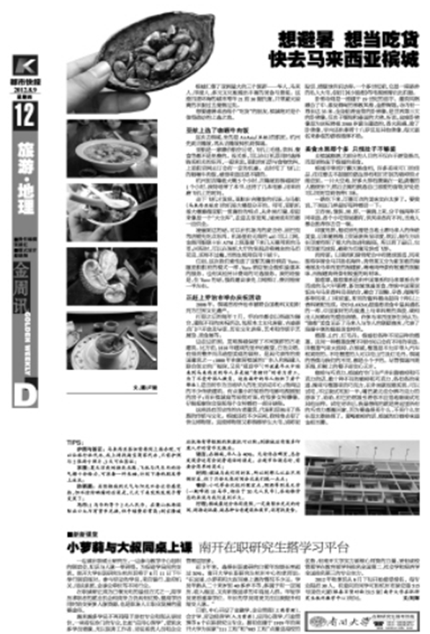
Clipping Samples – Dushi Kuaibao
Notes:
Objective/Target Consumer define/Habit/Rationale (cost? Coverage and Spots?)

Slide 7
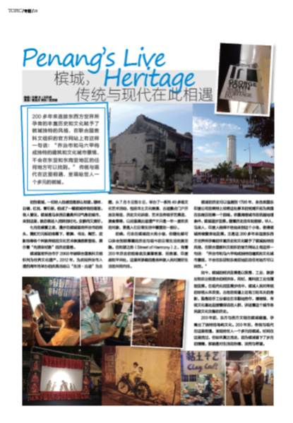
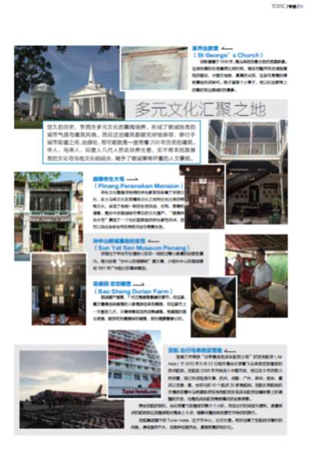
Clipping Samples – BQ
Notes:
Objective/Target Consumer define/Habit/Rationale (cost? Coverage and Spots?)

