Slide 1


^{Redberry Outdoors Sdn Bhd}
Rapid Penang Bus Advertising Certificate of Completion
Campaign : CAT – CNY Celebrations 2019
Campaign Period : 28 January 2019 – 27 February 2019
^{Sales Person : Sook Ching}
Contract No. : RBO/19/B4/220
Date of Completion : 26 January 2019
Redberry Outdoors Sdn Bhd Redberry City, Lot 2A, Jalan 13/2, 46200 Petaling Jaya Selangor Darul Ehsan
Tel : +603 7495 1155 Fax : +603 7495 1138 www.redberry.com.my

Slide 2

No. | Route | Bus Plate No | Depot | Model
1 | CAT | PJJ 1907 | WELD QUAY | SCANIA 10M K270

Slide 3
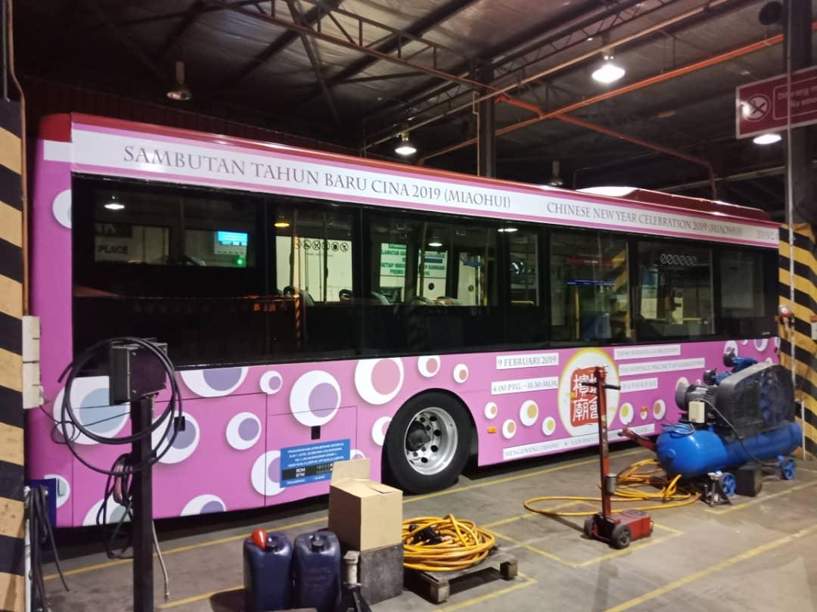
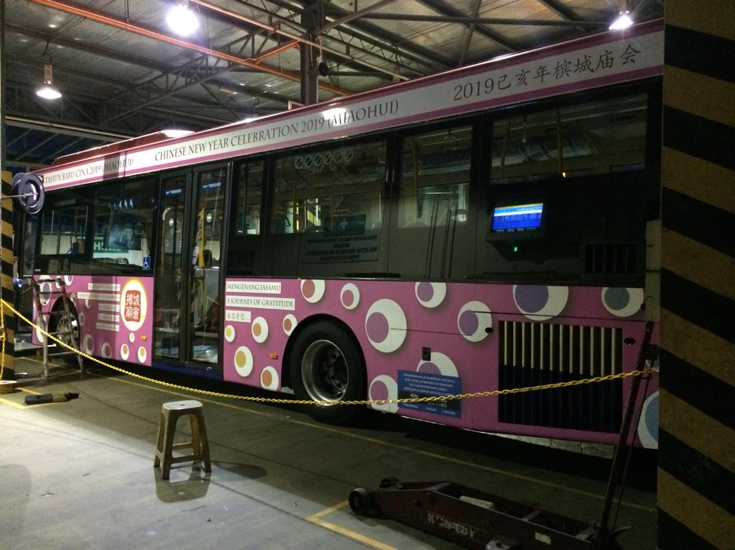
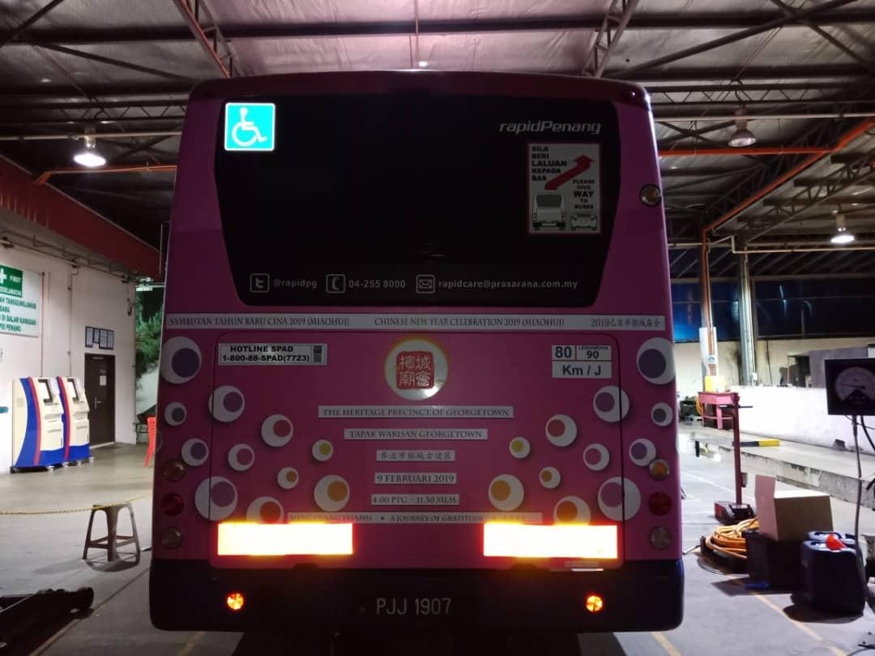
Bus Registration No. : PJJ 1907
^{Route No. : CAT}
^{Redberry Outdoors Sdn Bhd}
Redberry City, Lot 2A, Jalan 13/2, 46200 Petaling Jaya Selangor Darul Ehsan
Tel : +603 7495 1155 Fax : +603 7495 1138 www.redberry.com.my

