Slide 1


^{Redberry Outdoors Sdn Bhd}
Rapid Penang Bus Advertising Certificate of Completion
Campaign : Penang International Food Festival 2019
Campaign Period : 15 March 2019 – 14 April 2019
^{Sales Person : Sook Ching}
Contract No. : RBO/19/B4/225
Date of Completion : 15 March 2019
Redberry Outdoors Sdn Bhd Redberry City, Lot 2A, Jalan 13/2, 46200 Petaling Jaya Selangor Darul Ehsan
Tel : +603 7495 1155 Fax : +603 7495 1138 www.redberry.com.my

Slide 2

No. | Route | Bus Plate No | Depot | Model
1 | 701 | PJF 2914 | MAK MANDIN | SCANIA 12M K270
2 | 701 | PJF 1370 | MAK MANDIN | SCANIA 12M K270
3 | AT | PJJ 4732 | SG NIBONG | SCANIA 10M K270
4 | AT | PLL 7307 | SG NIBONG | SCANIA 10M K250
5 | 304 | PLL 7270 | SG NIBONG | SCANIA 10M K250
6 | 304 | PJL 9315 | SG NIBONG | SCANIA 10M K270
7 | 101 | PJL 9105 | WELD QUAY | SCANIA 10M K270
8 | 101 | PJL 9764 | WELD QUAY | SCANIA 10M K270

Slide 3
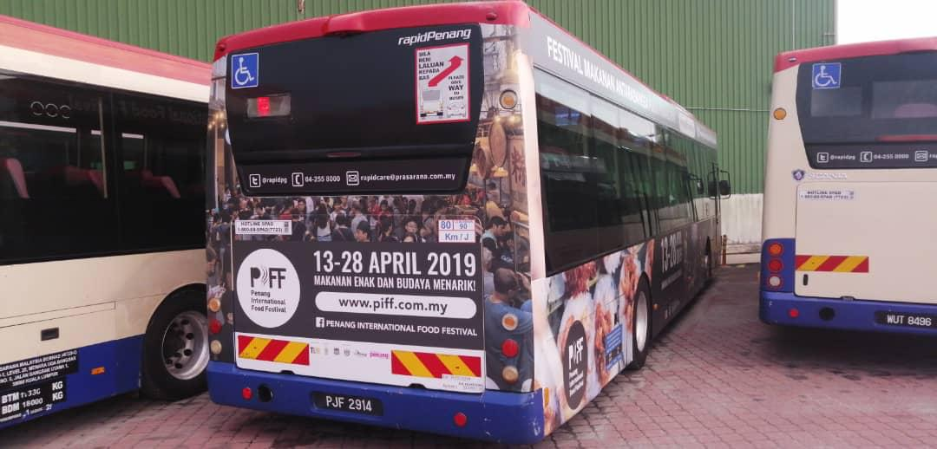
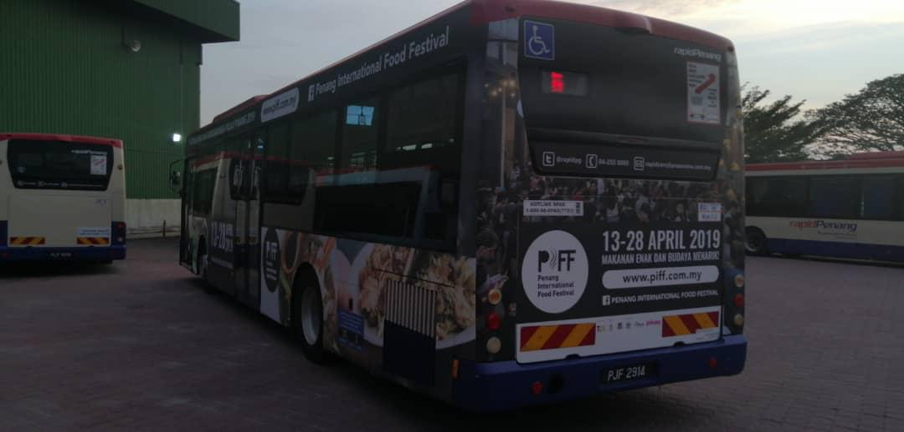
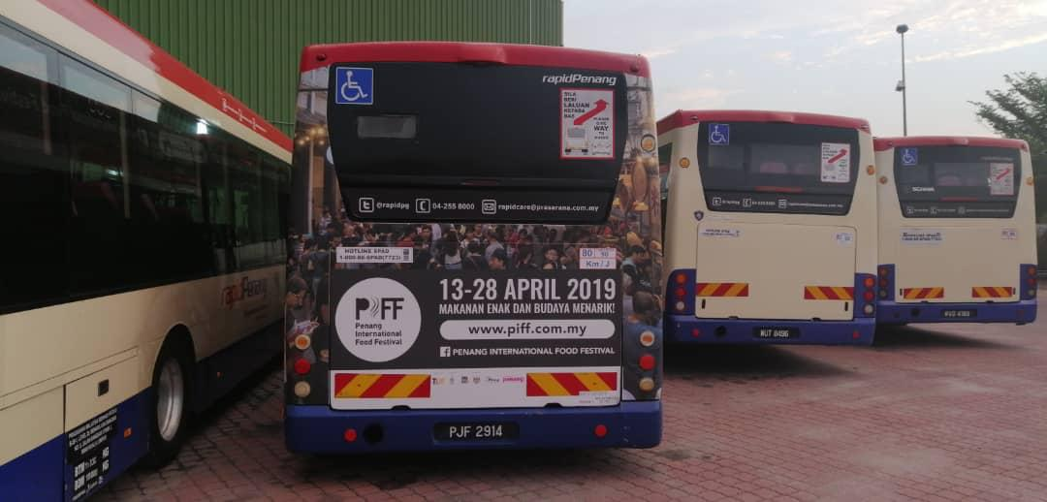
Bus Registration No. : PJF 2914
^{Route No. : 701}
^{Redberry Outdoors Sdn Bhd}
Redberry City, Lot 2A, Jalan 13/2, 46200 Petaling Jaya Selangor Darul Ehsan
Tel : +603 7495 1155 Fax : +603 7495 1138 www.redberry.com.my

Slide 4
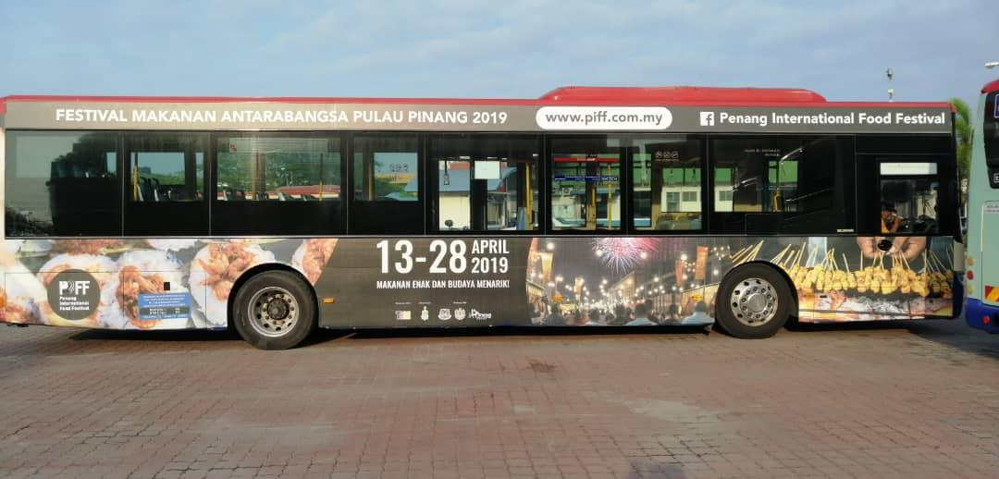
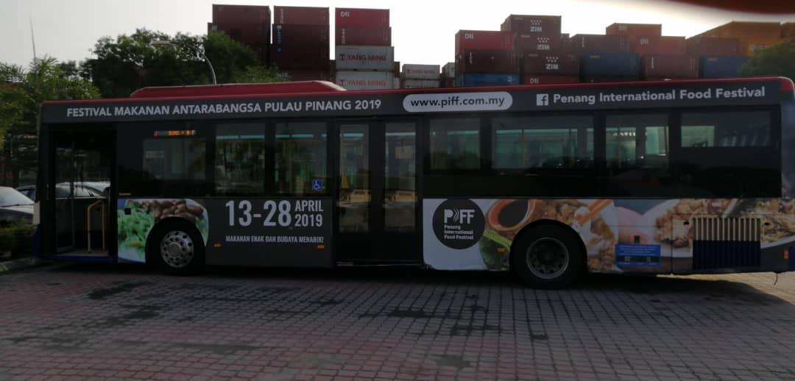
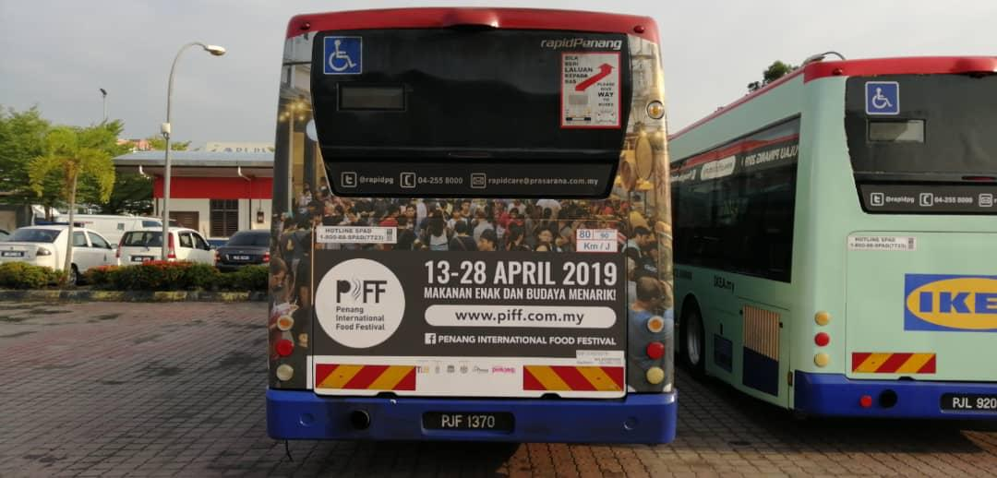
Bus Registration No. : PJF 1370
^{Route No. : 701}
^{Redberry Outdoors Sdn Bhd}
Redberry City, Lot 2A, Jalan 13/2, 46200 Petaling Jaya Selangor Darul Ehsan
Tel : +603 7495 1155 Fax : +603 7495 1138 www.redberry.com.my

Slide 5
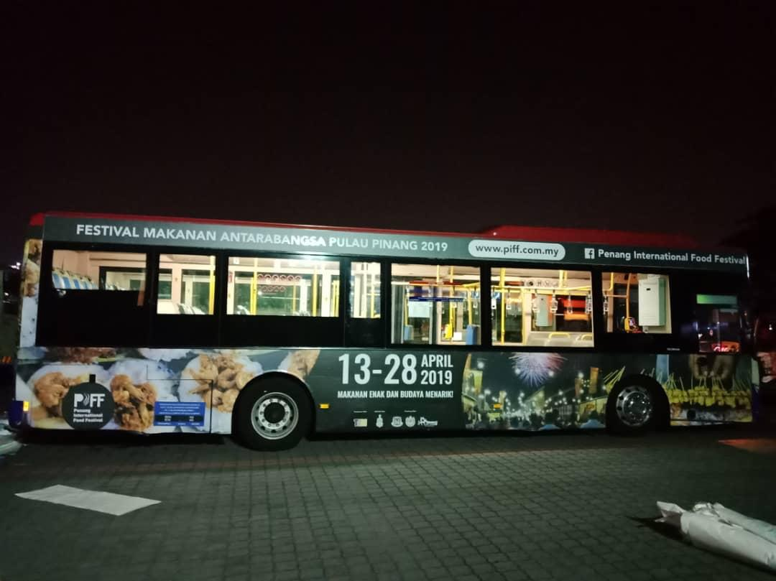
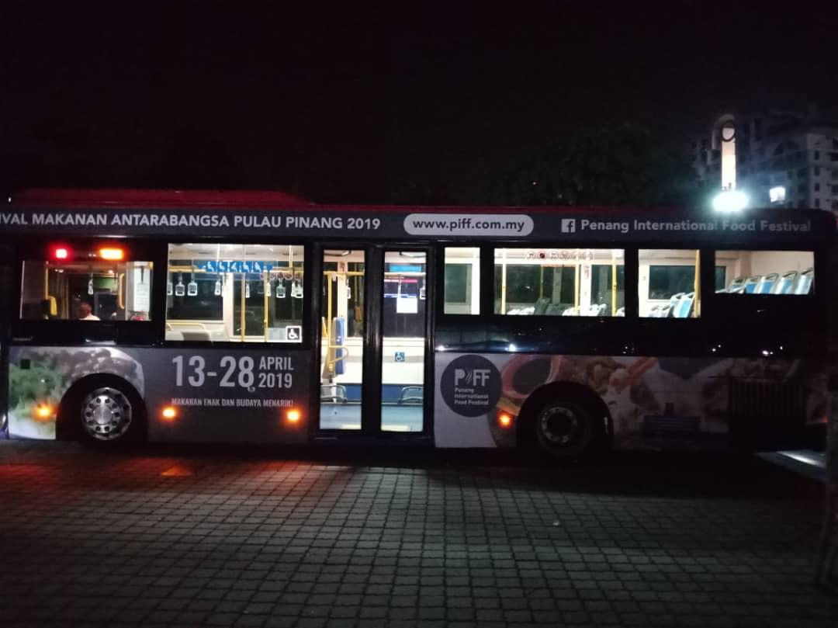
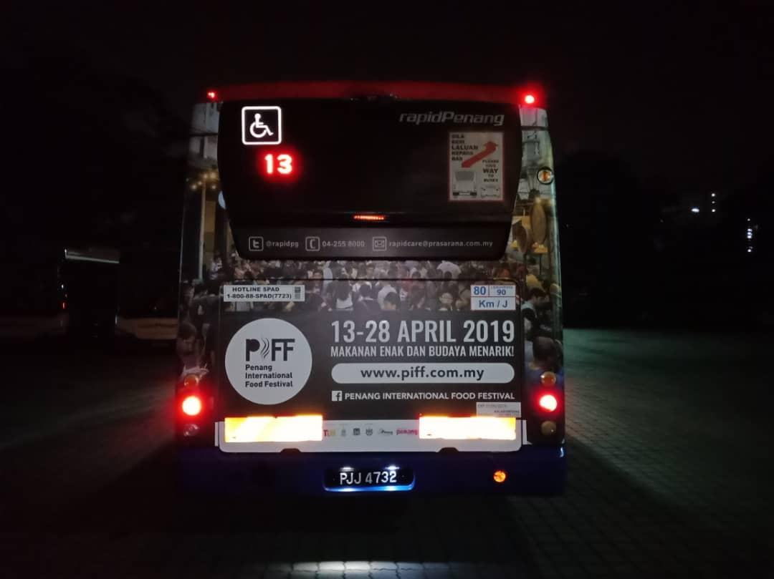
Bus Registration No. : PJJ 4732
^{Route No. : AT}
^{Redberry Outdoors Sdn Bhd}
Redberry City, Lot 2A, Jalan 13/2, 46200 Petaling Jaya Selangor Darul Ehsan
Tel : +603 7495 1155 Fax : +603 7495 1138 www.redberry.com.my

Slide 6
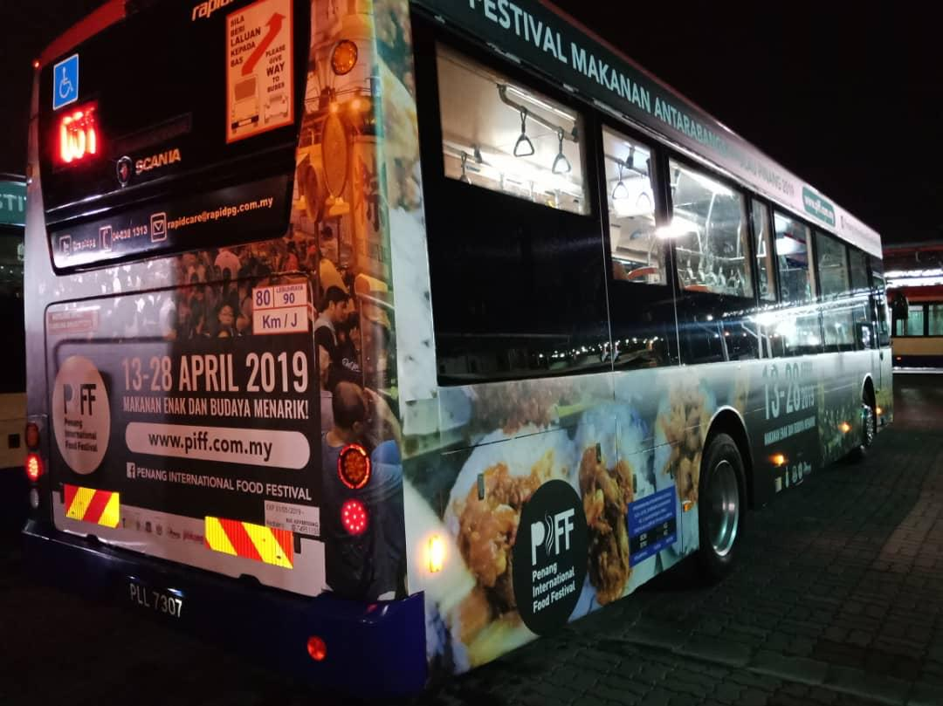
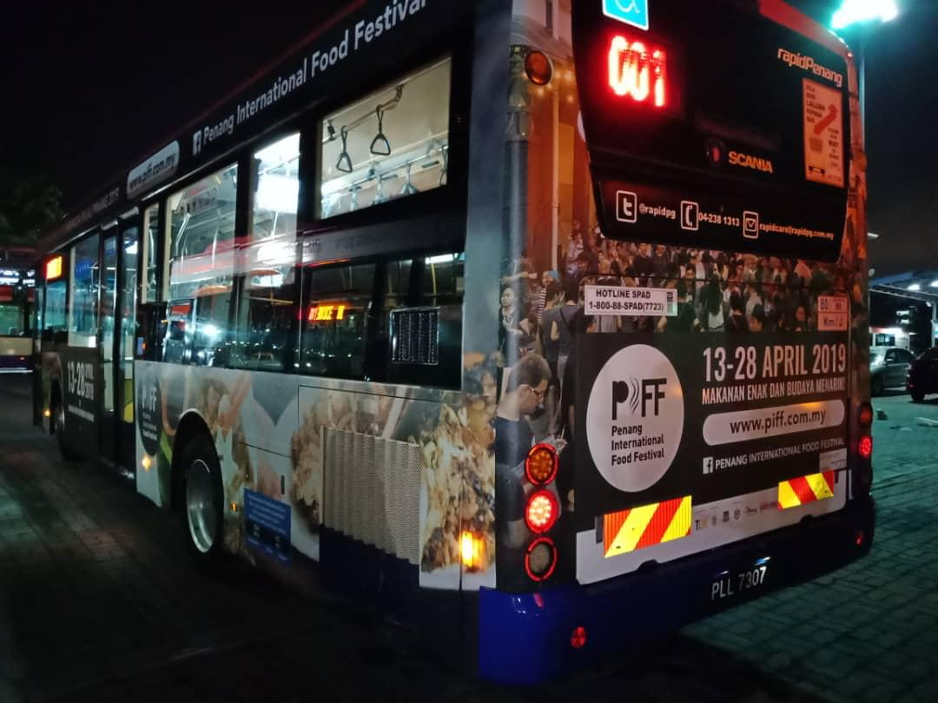
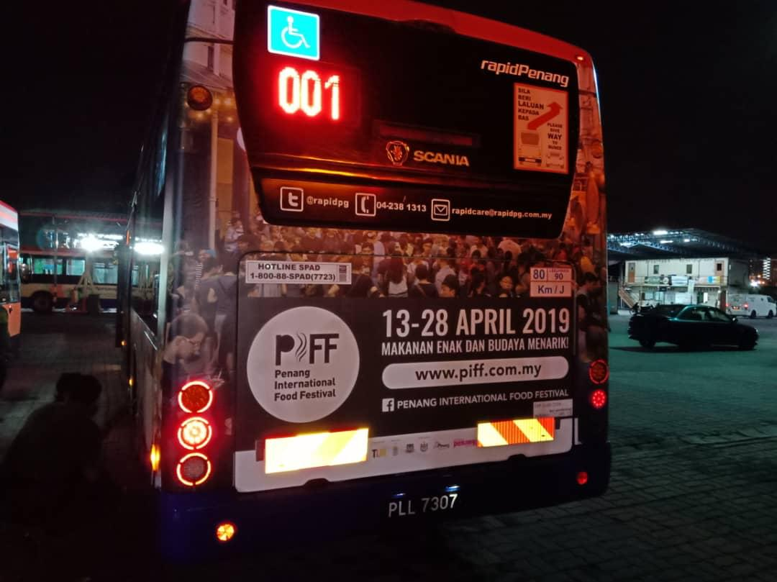
Bus Registration No. : PLL 7307
^{Route No. : AT}
^{Redberry Outdoors Sdn Bhd}
Redberry City, Lot 2A, Jalan 13/2, 46200 Petaling Jaya Selangor Darul Ehsan
Tel : +603 7495 1155 Fax : +603 7495 1138 www.redberry.com.my

Slide 7
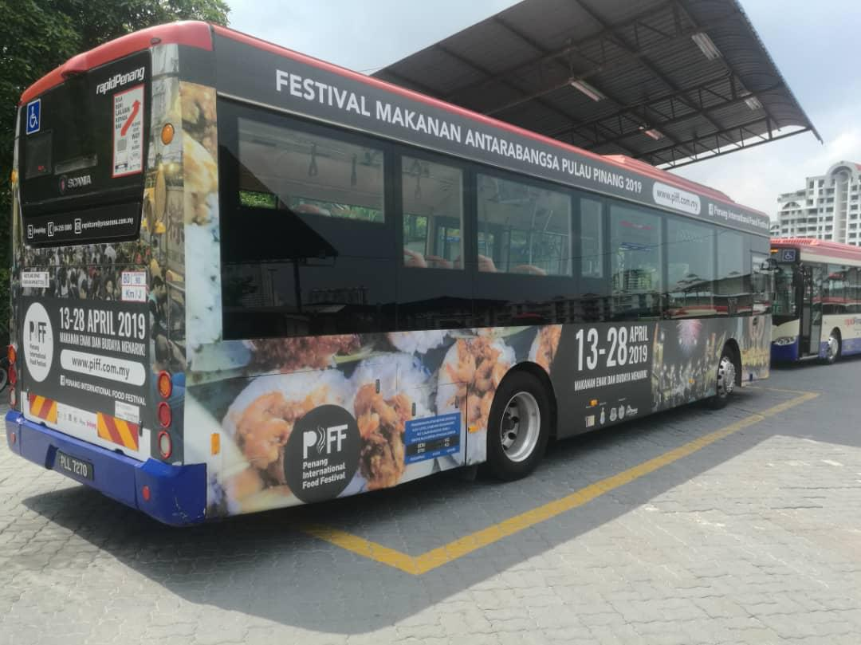
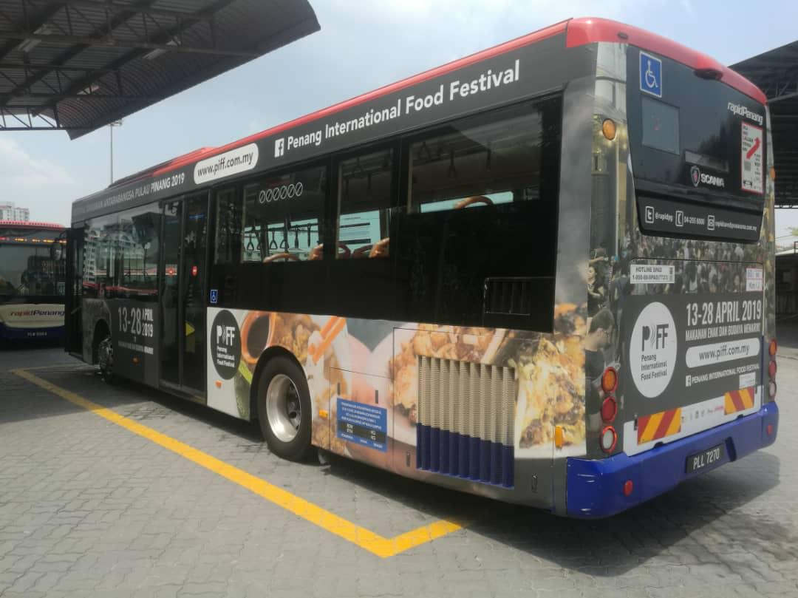
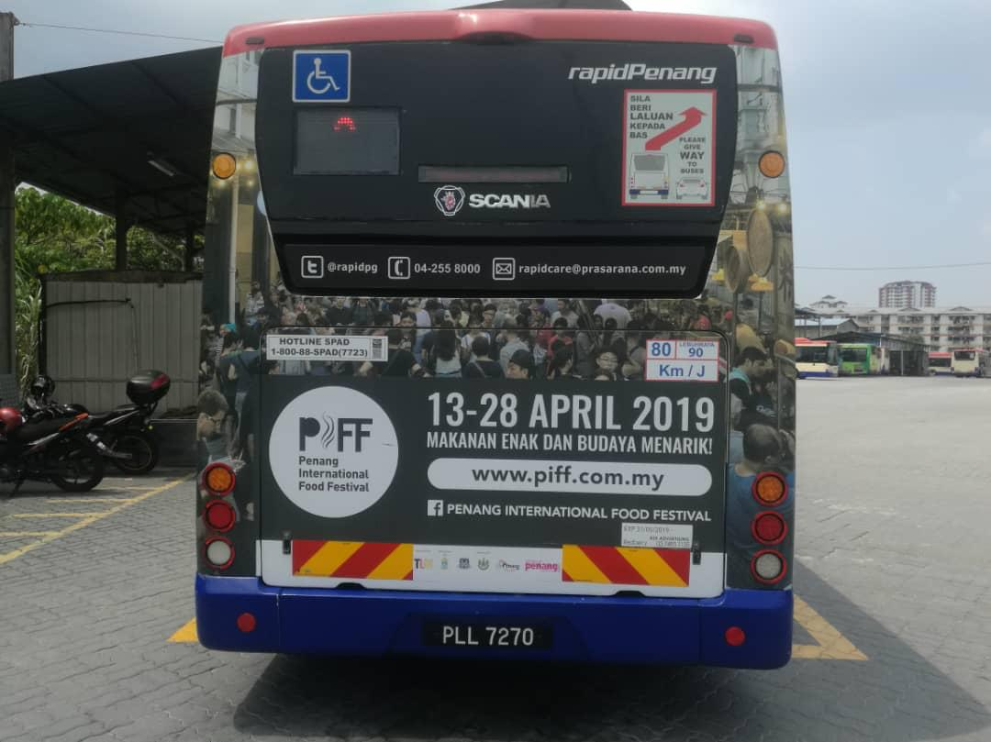
Bus Registration No. : PLL 7270
^{Route No. : 304}
^{Redberry Outdoors Sdn Bhd}
Redberry City, Lot 2A, Jalan 13/2, 46200 Petaling Jaya Selangor Darul Ehsan
Tel : +603 7495 1155 Fax : +603 7495 1138 www.redberry.com.my

Slide 8
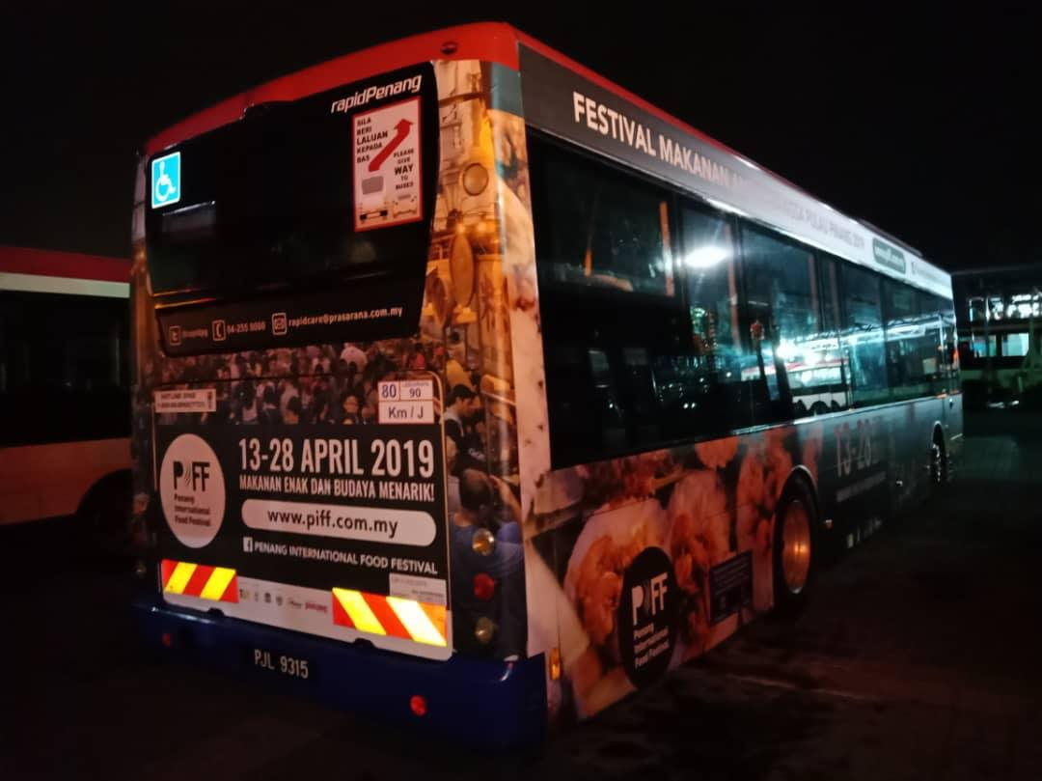
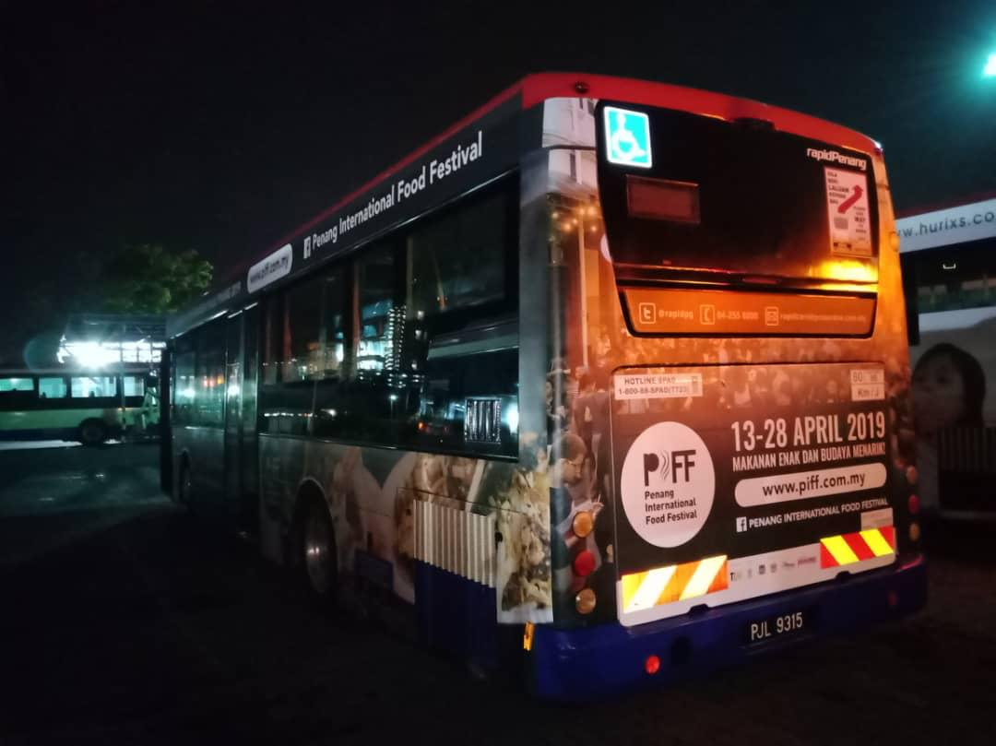
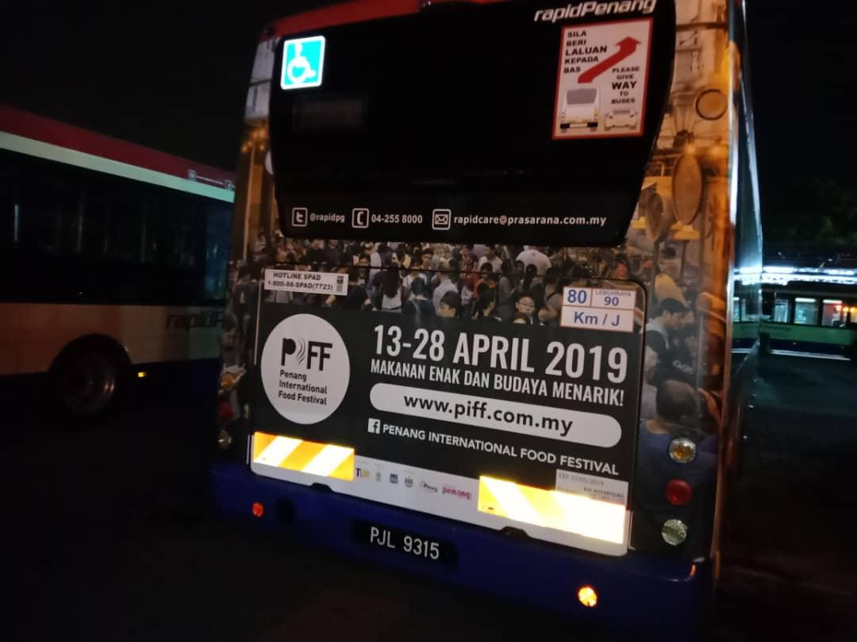
Bus Registration No. : PJL 9315
^{Route No. : 304}
^{Redberry Outdoors Sdn Bhd}
Redberry City, Lot 2A, Jalan 13/2, 46200 Petaling Jaya Selangor Darul Ehsan
Tel : +603 7495 1155 Fax : +603 7495 1138 www.redberry.com.my

Slide 9
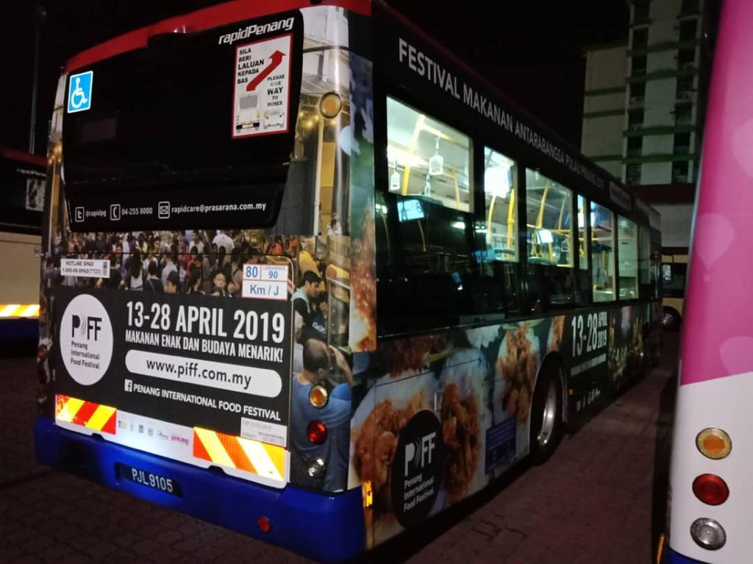
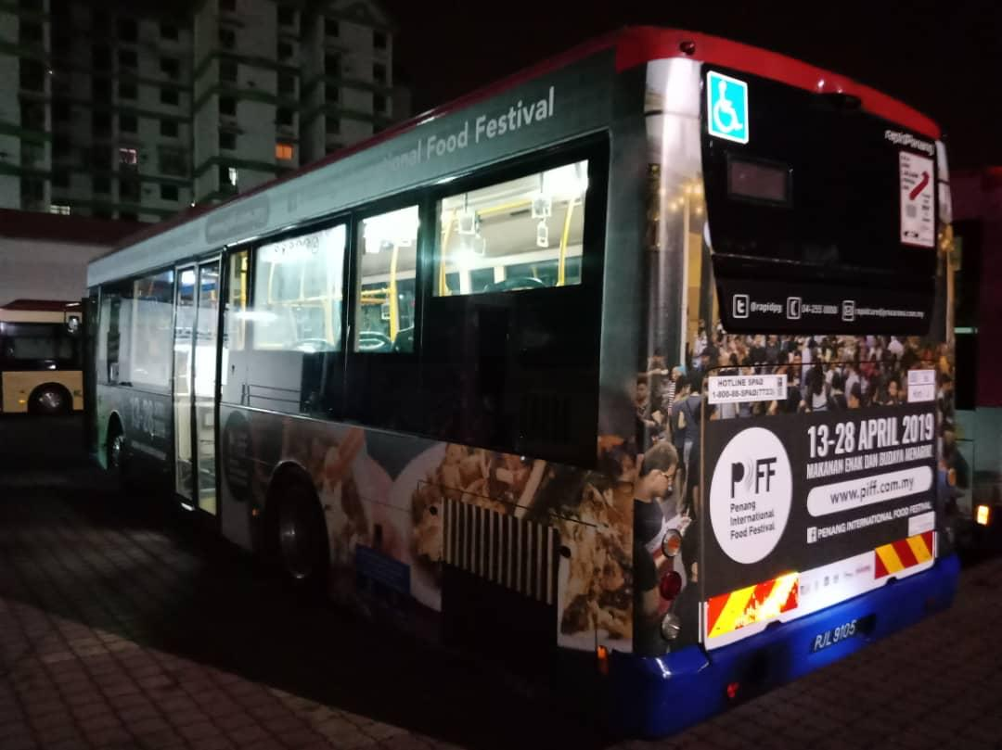
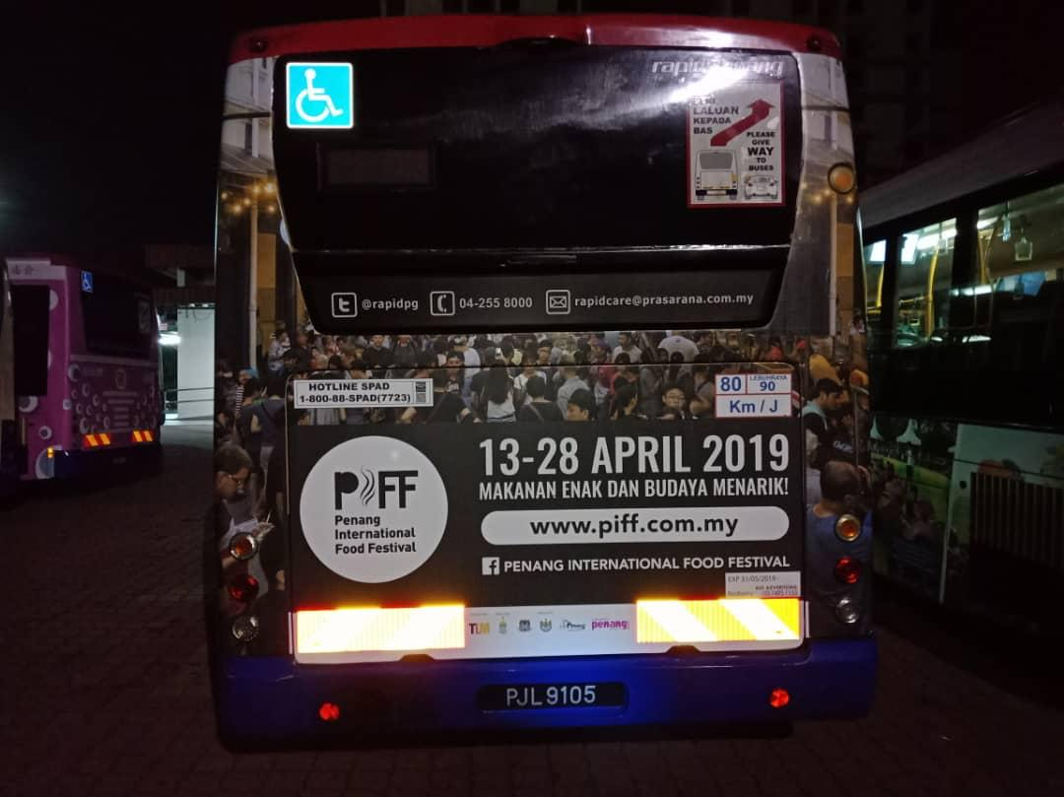
Bus Registration No. : PJL 9105
^{Route No. : 101}
^{Redberry Outdoors Sdn Bhd}
Redberry City, Lot 2A, Jalan 13/2, 46200 Petaling Jaya Selangor Darul Ehsan
Tel : +603 7495 1155 Fax : +603 7495 1138 www.redberry.com.my

Slide 10
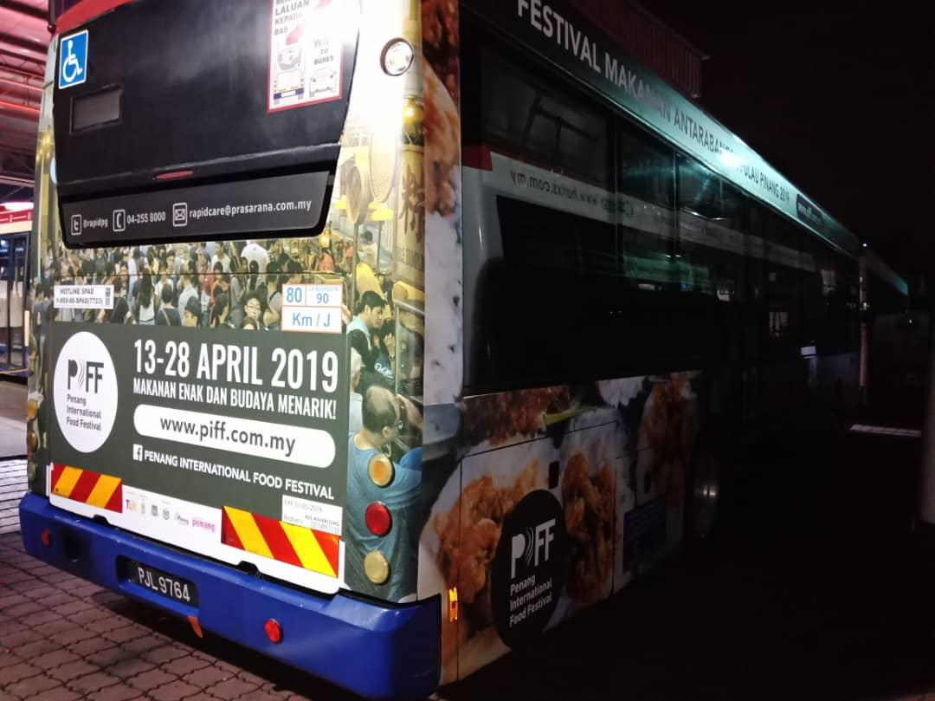
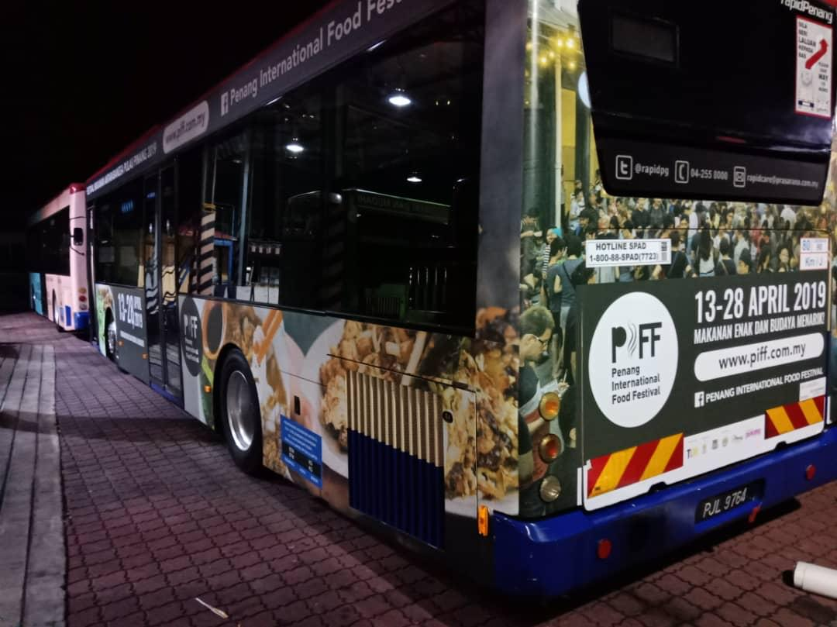
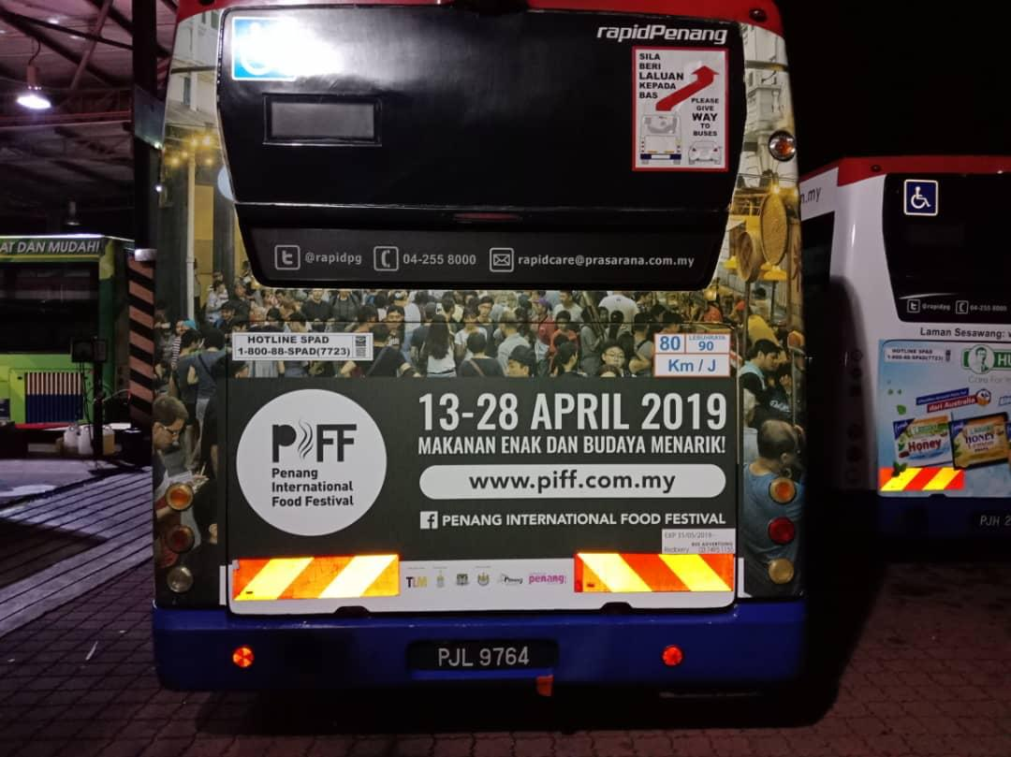
Bus Registration No. : PJL 9764
^{Route No. : 101}
^{Redberry Outdoors Sdn Bhd}
Redberry City, Lot 2A, Jalan 13/2, 46200 Petaling Jaya Selangor Darul Ehsan
Tel : +603 7495 1155 Fax : +603 7495 1138 www.redberry.com.my

