Slide 1
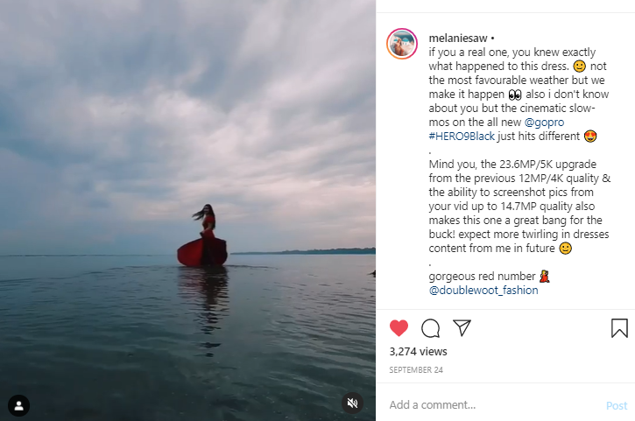
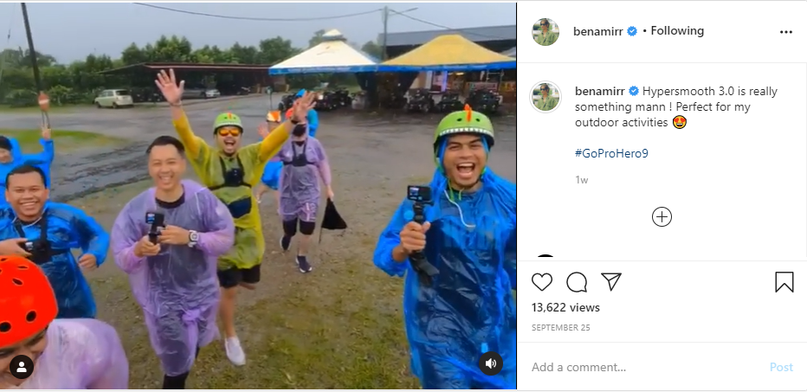
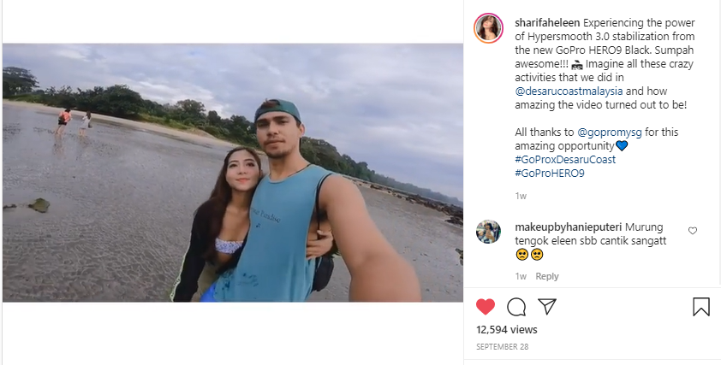
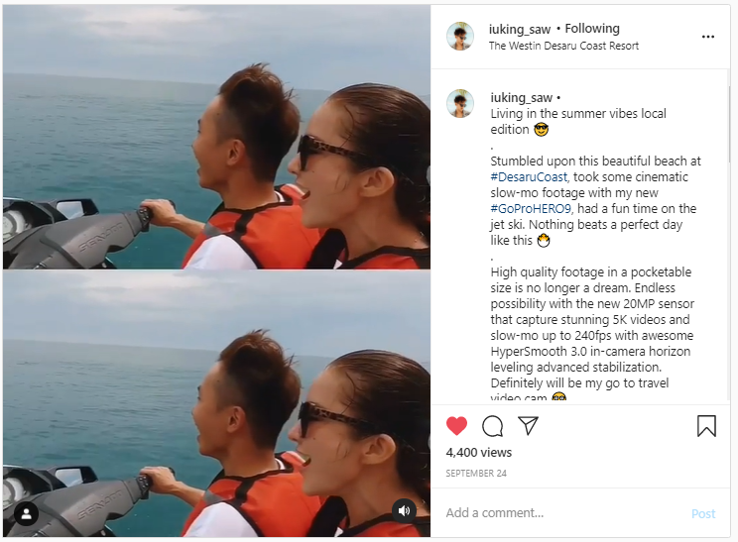
MY
COVERAGE – GOPRO HERO9 BLACK MEDIA TRIP
Media and KOLs published a total of 314 posts that earned 33,607,021 potential impressions.
Top-tier KOL coverage came from:
    Melanie Saw
    Ben Amir
    King Saw
    Sharifah Eleen
Key Quotes:
  “Hypersmooth 3.0 is really something mann ! Perfect for my outdoor activities .” – Ben Amir
  “High quality footage in a pocketable size is no longer a dream.” – King Saw
  “Mind you, the 23.6MP/5K upgrade from the previous 12MP/4K quality & the ability to screenshot pics from your video up to 14.7MP quality also makes this one a great bang for the buck!” – Melanie Saw
  “Experiencing the power of Hypersmooth 3.0 stabilization from the new GoPro HERO9 Black. Imagine all these crazy activities that we did in @desarucoastmalaysia and how amazing the video turned out to be!– Sharifah Eleen

Slide 2
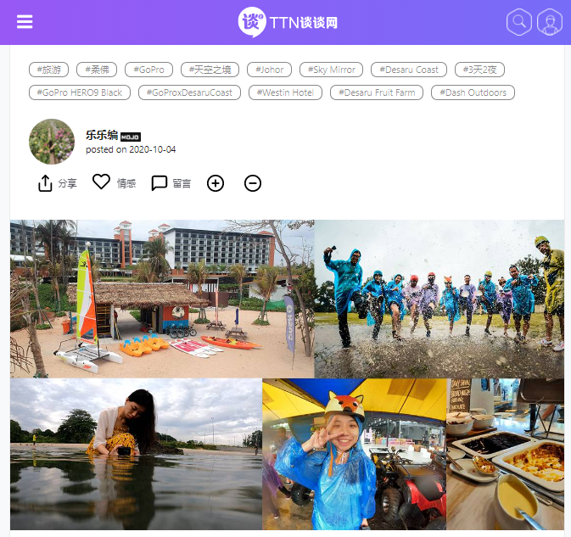
MY
COVERAGE – GOPRO HERO9 BLACK MEDIA TRIP
Media and KOLs published a total of 314 posts that earned 33,607,021 potential impressions.
Top-tier media coverage came from:
    Tantan News
*Tantan News will be publishing another article solely on GoPro
GO Communications is currently monitoring for more coverage from the media trip.
Key Quotes From Media Personnel:
  “I cannot believe how stunning the visuals look! Like seriously... how? #AnAbsoluteGoProFanNow” – Desiree Gasper, Senior Editor from Rojak Daily
  “I got to experience the stupendously stunning GoPro HERO9 Black myself! what can I say, I AM IN LOVE!” – Hanum Hayes, Tech Writer from New Straits Times
  “Every second is exciting whenever I have the GoPro HERO9 Black on hand” – Stella Chai, Senior Editor from Tantan News

