Slide 1


ENHANCE ENTRY POINT OF PENANG
BY INSTALLING BROCHURE RACK

Slide 2

Content
- Penang Sentral
- Rapid Ferry Penang (PengkalanSultan Abdul Halim Butterworth)
Bus Teriminal Sungai Nibong
Swettenham Pier Penang Port
KTM Butterworth

Slide 3
PENANG SENTRAL

Slide 4
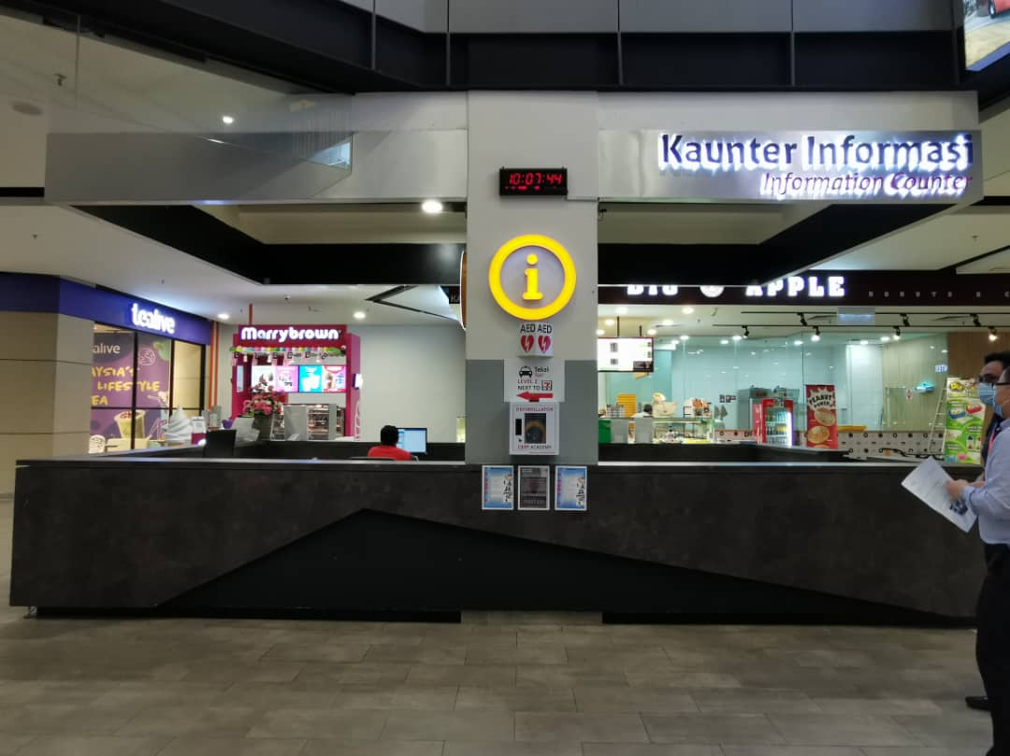

PENANG SENTRAL
6 ft (H)
3.5ft
6ft (W)
Place to put the brochure rack

Slide 5
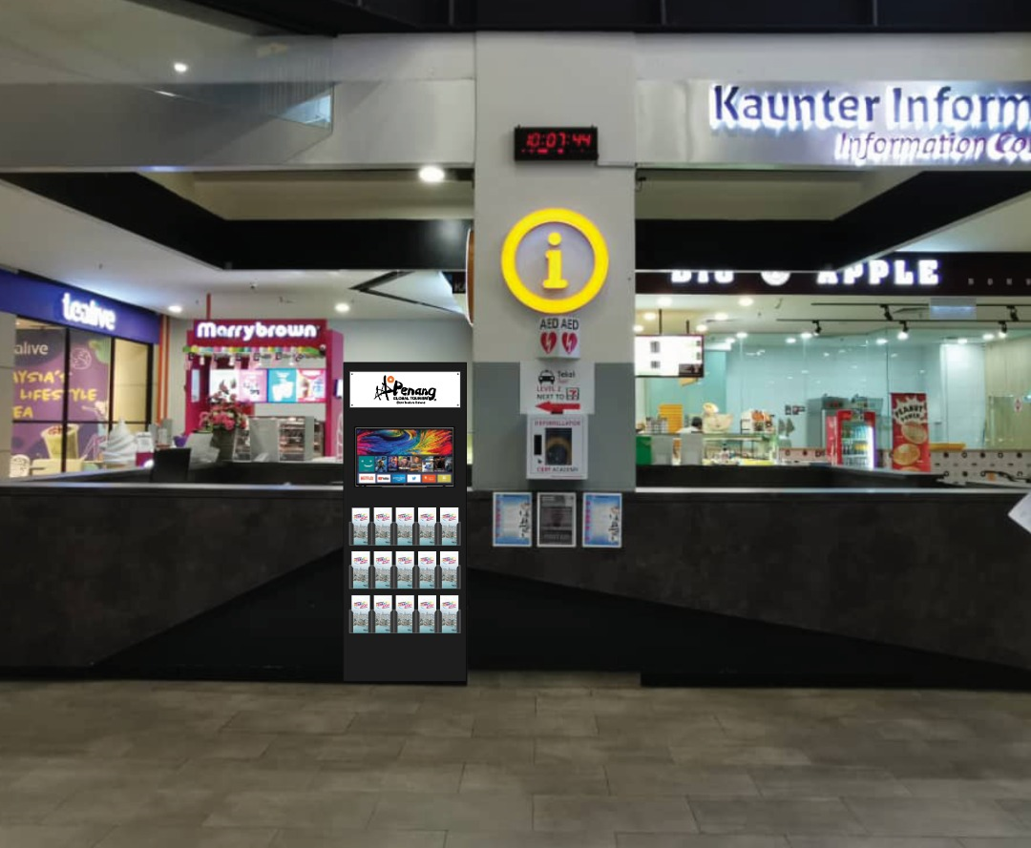
Superimposed design brochure rack for Penang Sentral
Superimposed design by ROD Creative

Slide 6
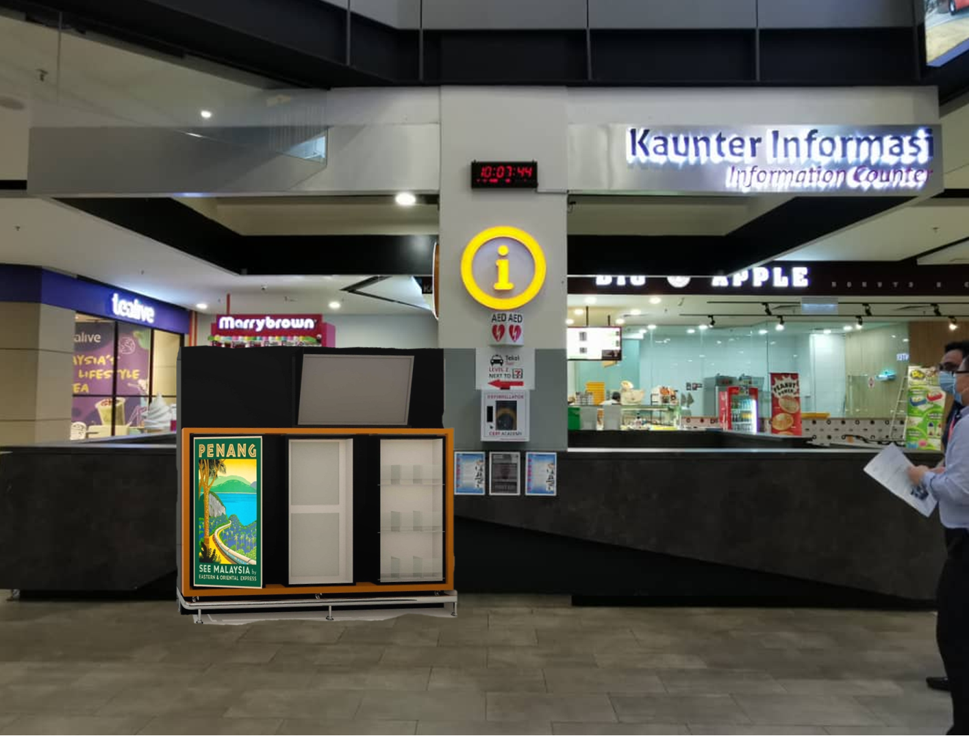
Superimposed design brochure rack for Penang Sentral
Superimposed design by DSOP Office

Slide 7
RAPID FERRY PENGKALAN SULTAN ABDUL HALIM

Slide 8

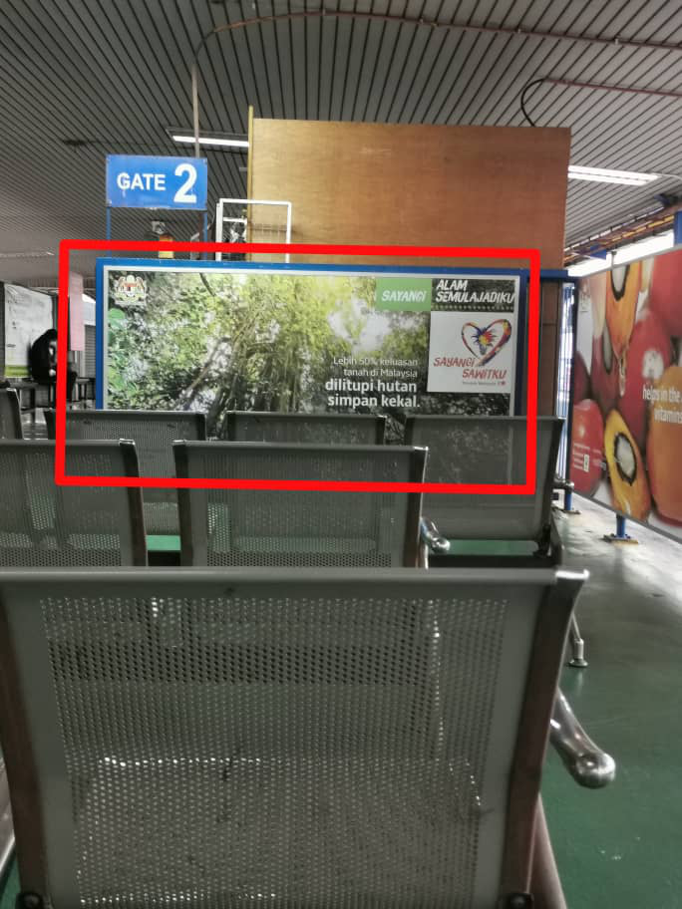
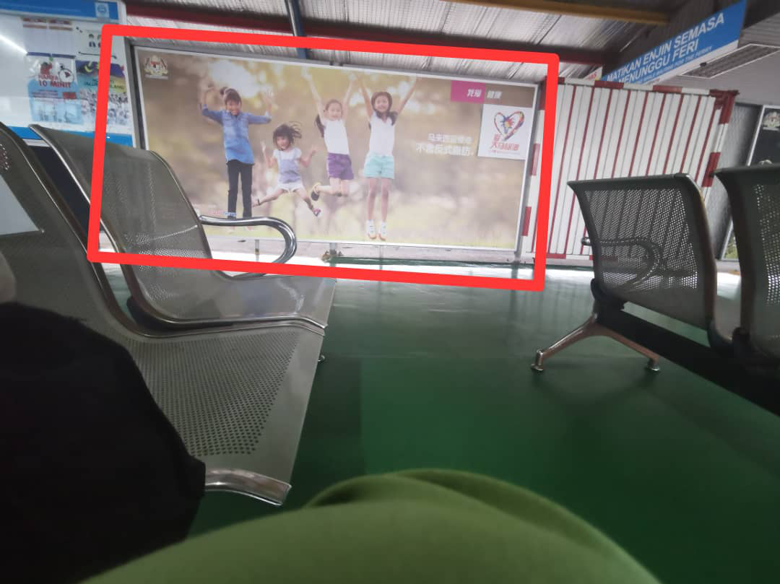
Panel 1 : 99.75’(W) x 52.5’(H)
Panel 2 : 147’(W) x 65’(H)

Slide 9
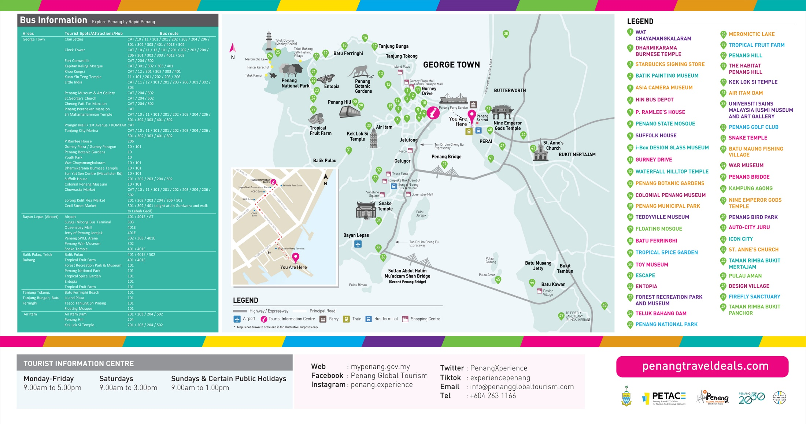
Panel 1 Design
Information on Bus route, Penang Map Attractions and direction to TIC from Ferry Pengakalan Raja Tun Uda

Slide 10
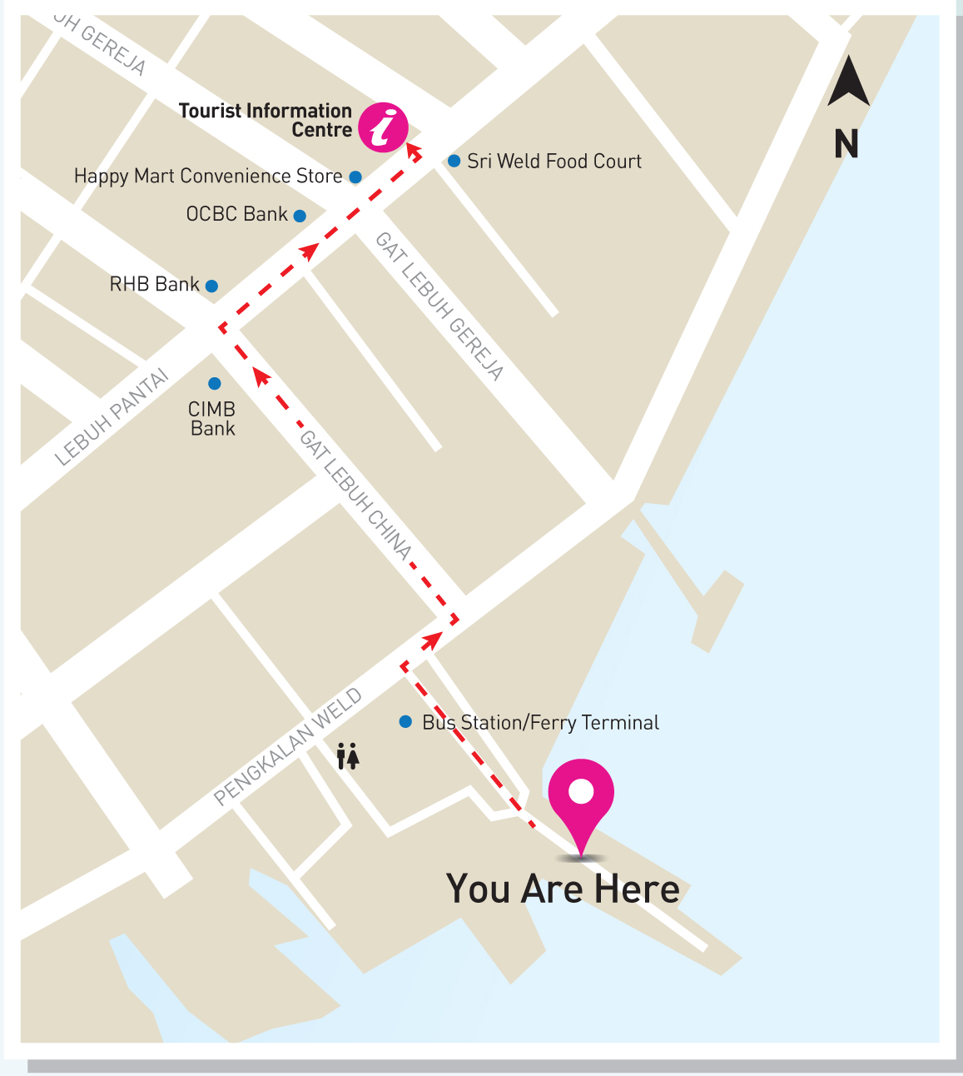
Up-close Direction Sign to TIC in Panel 1

Slide 11

Panel 2 Design
Information on Jom! Experience Penang – Penang Travel Deals Packages

Slide 12



Slide 13
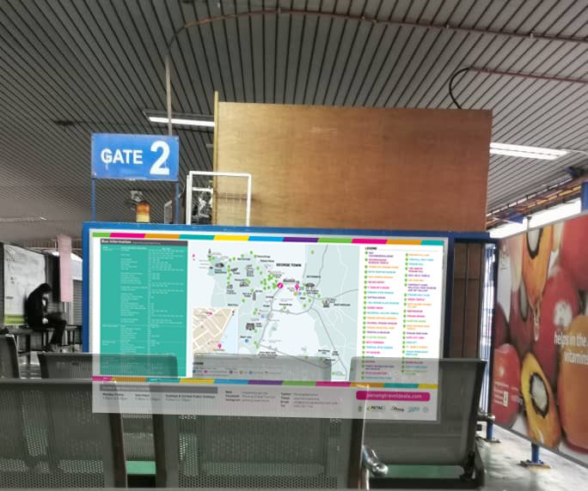
Superimposed for Design Panel 1

Slide 14
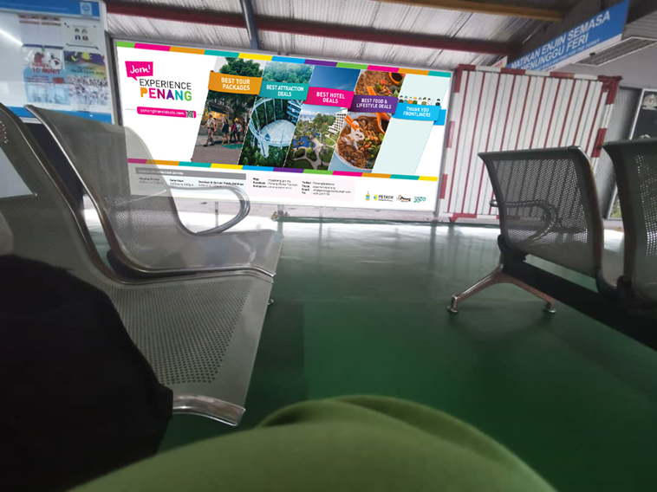
Superimposed Design Panel 2

Slide 15
SUNGAI NIBONG

Slide 16
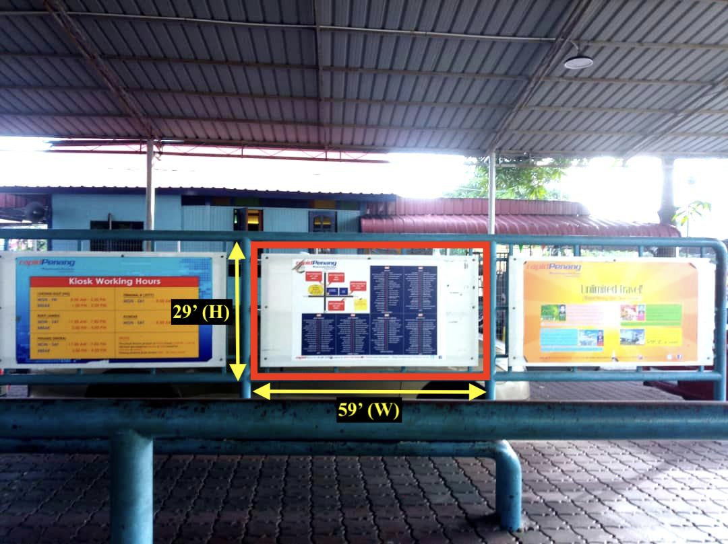
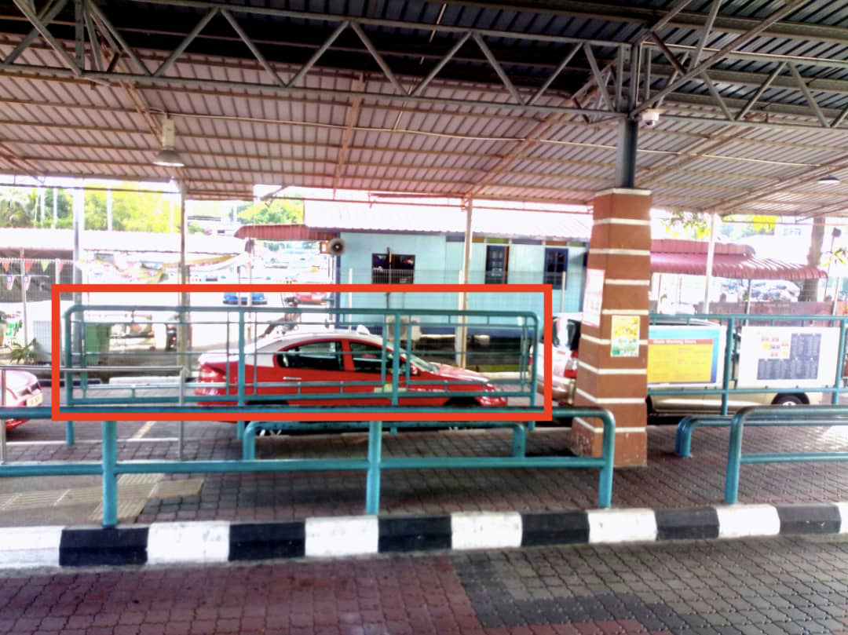
Sungai Nibong Bus Terminal
29’ (H)
52’ (W)
Size of panel : 52’(w) x 29’ (h)
3 empty panels to be utilized

Slide 17
SWETTENHAM PIER PENANG PORT

Slide 18
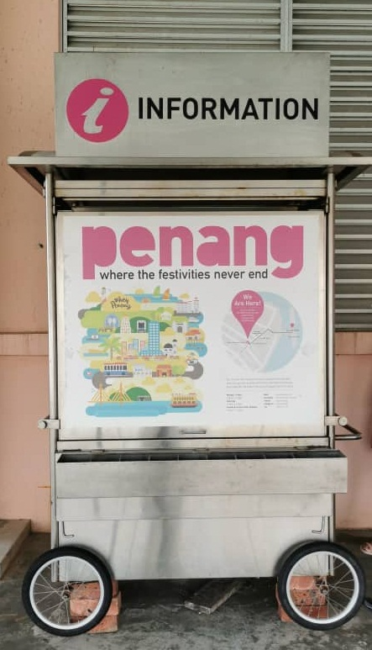
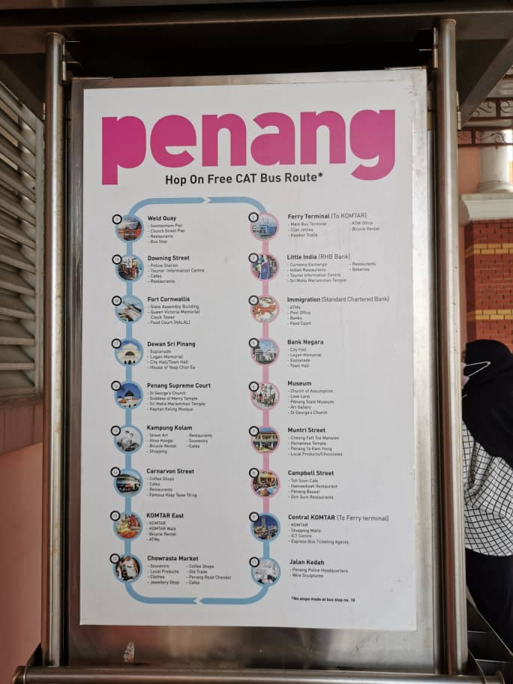
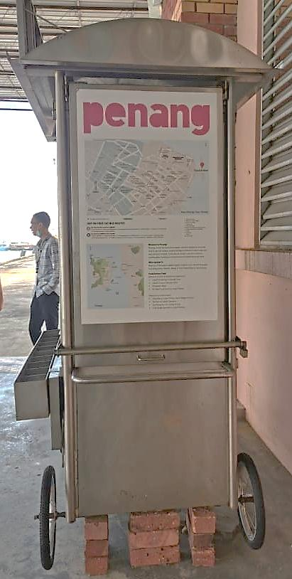
Information / brochure stall
Front image
Right side image
Left Side Image
The artwork (stickers on 4 sides), tires and body of stall will be changed to new ones.

Slide 19
KTM BUTTERWORTH

Slide 20
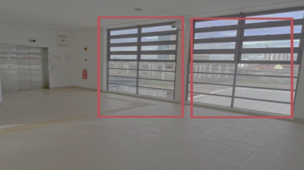
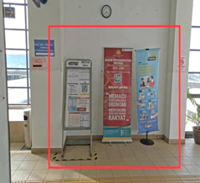
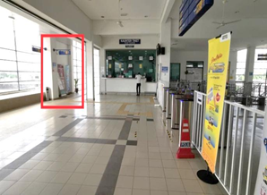
KTM BUTTERWORTH
Suggested place to put information rack

